Slide 1
Managing “Unfixable” CVEs
A governed operating model for evidence, disposition, controls, and continuous review
Evidence-led operating model
Created with AskAnything · askanything-app.com

Slide 2
The executive conclusion
02
Formal disposition, contextual exploitability analysis, and structural reduction are directionally sound—but neither “90 days” nor “no path found” is a universal safe harbor.
Managing “Unfixable” CVEs • approved evidence
Created with AskAnything · askanything-app.com

Slide 3
Two corrections before calling it compliance
03
NO UNIVERSAL 90 DAYS
REACHABILITY IS LAYERED
KEEP THE FINDING VISIBLE
The controlling interval comes from the applicable obligation and risk policy.
Call graphs, artifact inclusion, runtime, configuration, network, identity, and VEX answer different questions.
A disposition explains the finding; it must not erase the raw observation.
Managing “Unfixable” CVEs • approved evidence
Created with AskAnything · askanything-app.com

Slide 4
The defensible operating model
04
01
Verify finding + obligation
02
Classify disposition
03
Build exploitability + impact case
04
Prefer removal / supported change
05
Authorize residual risk
06
Continuously re-evaluate
Managing “Unfixable” CVEs • approved evidence
Created with AskAnything · askanything-app.com

Slide 5
A scanner match is a starting point
05
• Component and version may be misidentified.
• The deployed artifact may differ from build/test scope.
• Affected functions, features, or configurations may be absent.
• Attacker access, privilege, and trust boundaries still matter.
• Threat intelligence, business impact, and governing requirements remain separate inputs.
Managing “Unfixable” CVEs • approved evidence
Created with AskAnything · askanything-app.com

Slide 6
“Unfixable” is not a governance category
06
Technical state | Governed next move
No upstream fix | Remove, disable, isolate, monitor, or temporarily accept
End of life | Migrate, replace, isolate, or decommission
Fix incompatible | Engineer, isolate, or bound residual risk
Backport missed | Verify build; correct match or disposition
Code absent / conditions impossible | Evidence-backed not_affected
No path found | Prioritization evidence; define re-test triggers
Operationally deferred | Time-bounded remediation + interim controls
Managing “Unfixable” CVEs • approved evidence
Created with AskAnything · askanything-app.com

Slide 7
NIST: accountability plus continuous monitoring
07
• RMF connects assessment, authorization, risk decisions, and monitoring.
• OSCAL represents risks, deviations, remediation items, status, and evidence.
• A POA&M tracks weakness and corrective action; acceptance is a distinct response.
• Security supplies analysis; the designated risk owner owns the business consequence.
Managing “Unfixable” CVEs • approved evidence
Created with AskAnything · askanything-app.com

Slide 8
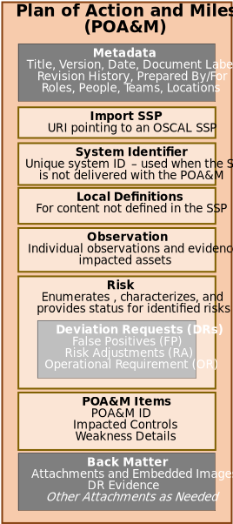
A POA&M is structured evidence
08
Source: NIST OSCAL — Plan of Action and Milestones Model — https://pages.nist.gov/OSCAL/learn/concepts/layer/assessment/poam/
Managing “Unfixable” CVEs • approved evidence
Created with AskAnything · askanything-app.com

Slide 9
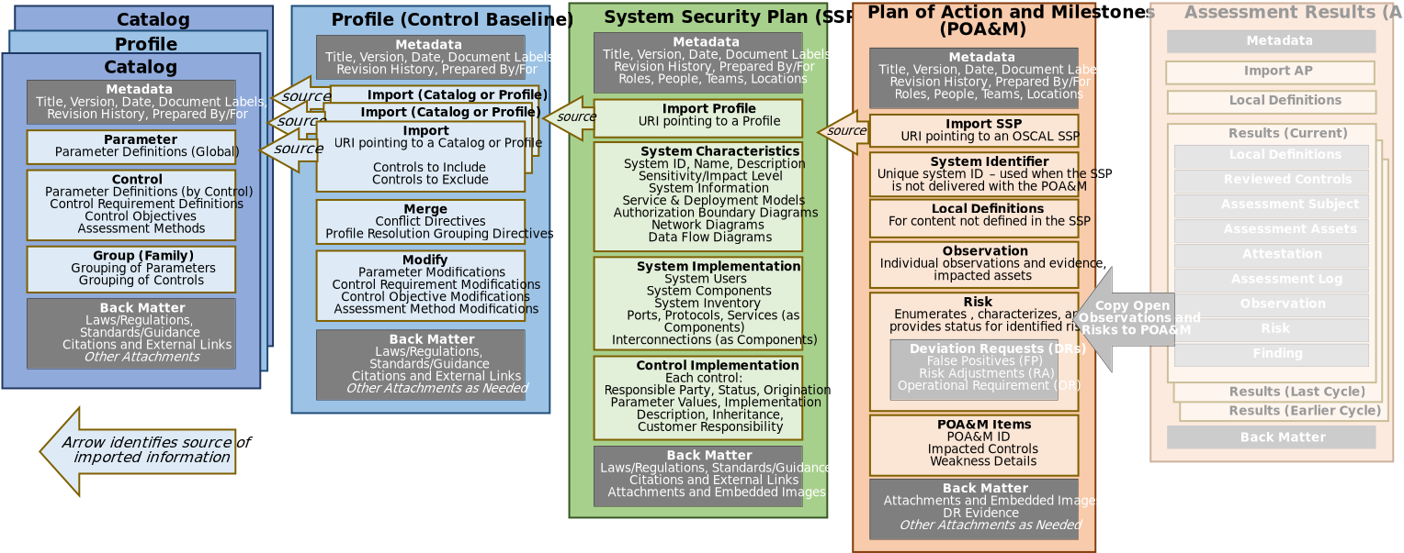
POA&M in the broader authorization stack
09
Source: NIST OSCAL — Plan of Action and Milestones Model — https://pages.nist.gov/OSCAL/learn/concepts/layer/assessment/poam/
Managing “Unfixable” CVEs • approved evidence
Created with AskAnything · askanything-app.com

Slide 10
Regimes constrain the available path
10
PCI DSS
CISA KEV
NIST / FedRAMP
Risk analysis cannot bypass an applicable requirement; compensating controls require documented constraint, rigor, testing, and maintenance.
Covered federal agencies must act by catalog due dates; ordinary queueing or generic acceptance cannot supersede them.
Represent ownership, planned action, risk decisions, and evidence without duplicating every provider record.
Managing “Unfixable” CVEs • approved evidence
Created with AskAnything · askanything-app.com

Slide 11
Review cadence is derived—not folklore
11
• External remediation deadline
• Exploitation status and speed
• Internet/adversary accessibility
• Asset and mission impact
• Interim-control stability and coverage
• Expected release or migration milestone
• Approved risk appetite and delegation
• Event-driven triggers
Managing “Unfixable” CVEs • approved evidence
Created with AskAnything · askanything-app.com

Slide 12
A rigorous workflow
Ten stages from raw finding to monitored disposition
Created with AskAnything · askanything-app.com

Slide 13
1 — Preserve and normalize the raw finding
13
• Scanner/database versions and timestamp
• CVE aliases, purl/CPE, version, architecture, digest
• Dependency path and runtime relevance
• Artifact/image digest and deployments
• Advisory ranges, severity, CVSS, fix state
• First/last seen, owners, data, zone, service
• Prior dispositions and authors
Managing “Unfixable” CVEs • approved evidence
Created with AskAnything · askanything-app.com

Slide 14
2 — Identify the exact obligation
14
• Framework, control, contract, boundary
• Prescriptive, objective-based, or risk-based
• Required interval and permitted alternatives
• Approver and assessor roles
• Evidence and retention requirements
• Special handling for KEV and regulated contexts
Managing “Unfixable” CVEs • approved evidence
Created with AskAnything · askanything-app.com

Slide 15
3 — Validate identity and applicability
15
• Confirm the component is in the deployable artifact.
• Use the ecosystem’s version semantics.
• Check distributor backports and supplier advisories.
• Separate source, metadata, cache, test fixture, and runtime dependency.
• False positive ≠ not affected ≠ accepted risk.
Managing “Unfixable” CVEs • approved evidence
Created with AskAnything · askanything-app.com

Slide 16
4 — Map the actual attack path
16
01
Untrusted boundary
02
Reachable interface
03
Identity / tenant gate
04
Effective configuration
05
Application call path
06
Sandbox + consequence
Managing “Unfixable” CVEs • approved evidence
Created with AskAnything · askanything-app.com

Slide 17
5 — Layer reachability evidence
17
• Source/call graph: positive path is strong; negative result is limited.
• Build/artifact: prove what enters the final immutable artifact.
• Runtime: observed execution does not cover every adversarial input.
• Network + identity: test deployed routes and required principals.
• Configuration: capture effective runtime settings and overlays.
• Keep threat, exploitability, exposure, asset value, and impact distinct.
Managing “Unfixable” CVEs • approved evidence
Created with AskAnything · askanything-app.com

Slide 18
Reachability tools are not interchangeable
18
SNYK
GRYPE
EPSS
Documents source/call-graph reachability for supported cases and says NO PATH FOUND is not proof.
Matches package identity/version to vulnerability data and can consume VEX; it does not prove a call path.
Estimates near-term exploitation activity; it excludes the local environment, controls, and impact.
Managing “Unfixable” CVEs • approved evidence
Created with AskAnything · askanything-app.com

Slide 19
6 — Express the conclusion with VEX
19
• Scope the exact product, version, artifact, and vulnerability.
• Use not_affected only when evidence supports it.
• Preserve provenance, approval, reasoning, and conditions.
• Distribute one disposition to scanners, dashboards, tickets, and assurance.
• Expire or supersede it when assumptions change.
Managing “Unfixable” CVEs • approved evidence
Created with AskAnything · askanything-app.com

Slide 20
7 — Prefer structural reduction
20
• Remove packages, features, endpoints, services, or assets.
• Use multi-stage builds and copy only required runtime artifacts.
• Favor minimal trusted bases and rebuild frequently.
• Scan and deploy by immutable digest.
• Verify the final artifact—not merely the Dockerfile or build stage.
Managing “Unfixable” CVEs • approved evidence
Created with AskAnything · askanything-app.com

Slide 21
Minimal images: benefit with trade-offs
21
BENEFIT
TRADE-OFF
VERIFY
Omitting software removes associated attack surface and findings.
Diagnostics, forensics, libc behavior, certificates, time zones, and runtime assumptions may change.
Test startup, TLS, DNS, health, signals, observability, crash handling, and incident response.
Managing “Unfixable” CVEs • approved evidence
Created with AskAnything · askanything-app.com

Slide 22
8 — Test controls against the exploit chain
22
Prerequisite | Candidate control | Retained evidence
Request reaches endpoint | Route/WAF/gateway deny | Config + external/bypass test
Untrusted file reaches parser | Allowlist/CDR/sandbox | Corpus + policy + alerts
Feature enabled | Disable + config lock | Effective config + drift alert
Privileged identity required | Strong auth + least privilege | Export + review + simulation
Lateral movement | Segmentation + workload identity | Reachability matrix + denied logs
Code execution consequence | Non-root + RO FS + LSM | Runtime spec + enforcement test
Command-and-control | Default-deny egress | Policy + denied-domain test
Managing “Unfixable” CVEs • approved evidence
Created with AskAnything · askanything-app.com

Slide 23
9 — Make the decision reproducible
23
• Identity and immutable scope
• Finding validation and authoritative advisory
• Threat and layered attack-path evidence
• Response, alternatives, controls, residual risk
• Owner, funding, milestones, approval, expiration
• VEX/suppression lifecycle and audit log
• Re-scan, tests, and closure evidence
Managing “Unfixable” CVEs • approved evidence
Created with AskAnything · askanything-app.com

Slide 24
10 — Review by time and event
24
• Patch, supported release, or mitigation appears
• Component, code, configuration, or zone changes
• Sensitive-data use changes
• KEV or exploit intelligence changes
• EPSS moves materially
• Control drifts or fails
• Risk owner, tolerance, framework, or contract changes
• Expiration is reached
Managing “Unfixable” CVEs • approved evidence
Created with AskAnything · askanything-app.com

Slide 25
Evidence hierarchy
25
01
Direct remediation / removal
02
Product-specific supplier evidence
03
Reproducible technical evidence
04
Control-effectiveness evidence
05
Reasoned analysis
06
Unsupported assertion
Managing “Unfixable” CVEs • approved evidence
Created with AskAnything · askanything-app.com

Slide 26
The original three steps: keep, but qualify
26
FORMAL ACCEPTANCE
CONTEXTUAL REACHABILITY
STRUCTURAL REDUCTION
Use authorized ownership, residual risk, controls, end condition, and applicable cadence.
Use layered evidence; do not turn NO PATH FOUND into proof.
Remove exposure and verify the final deployed artifact; CVE count alone is not risk.
Managing “Unfixable” CVEs • approved evidence
Created with AskAnything · askanything-app.com

Slide 27
Scale the model
Policy, data, and automation replace endless manual exceptions
Created with AskAnything · askanything-app.com

Slide 28
Implementation blueprint
28
POLICY
DATA
AUTOMATION
Taxonomy, evidence rules, approval matrix, duration, triggers, and raw audit view.
CVE aliases, purl, SBOM, digests, commit, deployment, controls, and risk IDs.
Generate, scan, enrich, analyze, apply approved VEX, route, re-evaluate, revoke, retain.
Managing “Unfixable” CVEs • approved evidence
Created with AskAnything · askanything-app.com

Slide 29
Metrics that reward real reduction
29
• Affected findings by asset criticality
• KEV exposure and time to required action
• Fix availability to verified deployment
• Exception age and renewal count
• Unsupported/EOL components
• Immutable artifact scope coverage
• Control tests and drift
• Revalidation after change
• Components removed and attack paths closed
Managing “Unfixable” CVEs • approved evidence
Created with AskAnything · askanything-app.com

Slide 30
Concise decision procedure
30
01
Wrong match? → false_positive
02
Conditions absent? → not_affected
03
Can remove/disable? → avoid
04
Fix/mitigation? → implement
05
Mandatory deadline? → follow it
06
Controls sufficient? → mitigate
07
Acceptance permitted? → authorize
08
Otherwise → isolate / replace / deny
Managing “Unfixable” CVEs • approved evidence
Created with AskAnything · askanything-app.com

Slide 31
The trustworthy chain
31
finding → validated identity → affected conditions → deployment context → exploitability / threat / impact → response → tested residual risk → accountable approval → continuous review → verified closure
Managing “Unfixable” CVEs • approved evidence
Created with AskAnything · askanything-app.com

Slide 32
Ownership makes the model work
32
SECURITY ENGINEERING
PLATFORM + PRODUCT
BUSINESS + GRC + AUDIT
Evidence quality and technical analysis.
Removal, upgrades, rebuilds, and operational controls.
Risk ownership, allowed paths, deadlines, reconciliation, and reconstructability.
Managing “Unfixable” CVEs • approved evidence
Created with AskAnything · askanything-app.com

Slide 33
Sources
1. NIST SP 800-40 Rev. 4, Guide to Enterprise Patch Management Planning
https://doi.org/10.6028/NIST.SP.800-40r4
2. NIST SP 800-37 Rev. 2, Risk Management Framework for Information Systems and Organizations
https://doi.org/10.6028/NIST.SP.800-37r2
3. NIST CSRC, “compensating security control”
https://csrc.nist.gov/glossary/term/compensating_security_control
4. NIST OSCAL, “Plan of Action and Milestones Model”
https://pages.nist.gov/OSCAL/learn/concepts/layer/assessment/poam/
5. NIST OSCAL POA&M JSON definitions
https://pages.nist.gov/OSCAL-Reference/models/v1.2.0/plan-of-action-and-milestones/json-definitions/
6. FedRAMP, “Agency Plans of Action and Milestones”
https://www.fedramp.gov/2026/agencies/use/ongoing/poams/
7. PCI SSC FAQ 1597
https://www.pcisecuritystandards.org/faqs/1597/
8. PCI SSC, “Do all PCI DSS requirements apply to every system component?”
https://www.pcisecuritystandards.org/faqs/do-all-pci-dss-requirements-apply-to-every-system-component/
9. PCI SSC, “PCI DSS v4.0: Compensating Controls vs Customized Approach”
https://blog.pcisecuritystandards.org/pci-dss-v4-0-compensating-controls-vs-customized-approach
10. PCI DSS v4.0 SAQ D Merchant, Appendix B
https://www.pcisecuritystandards.org/documents/PCI-DSS-v4-0-SAQ-D-Merchant.pdf
11. CISA Known Exploited Vulnerabilities Catalog
https://www.cisa.gov/known-exploited-vulnerabilities-catalog
12. CISA, Minimum Requirements for Vulnerability Exploitability eXchange (VEX)
https://www.cisa.gov/sites/default/files/2023-04/minimum-requirements-for-vex-508c.pdf
13. CISA SBOM Resources Library
https://www.cisa.gov/topics/cyber-threats-and-advisories/sbom/sbomresourceslibrary
14. Snyk, “Reachability analysis”
https://docs.snyk.io/manage-risk/prioritize-issues-for-fixing/reachability-analysis
15. Anchore Open Source, “Grype”
https://oss.anchore.com/docs/architecture/grype/
16. Anchore Open Source, “Filter scan results”
https://oss.anchore.com/docs/guides/vulnerability/filter-results/
17. FIRST, “The EPSS Model”
https://www.first.org/epss/model
18. FIRST, “EPSS Frequently Asked Questions”
https://www.first.org/epss/faq
19. Docker, “Building best practices”
https://docs.docker.com/build/building/best-practices/
20. Docker, “Multi-stage builds”
https://docs.docker.com/build/building/multi-stage/
Explore more questions at Ask Anything
Managing “Unfixable” CVEs • approved evidence
Created with AskAnything · askanything-app.com

