Slide 1
SUPPLY-CHAIN INCIDENT ANALYSIS
The Adform Trackpoint
Compromise
How a Single Ad-Tech Script Became a Cryptocurrency-Address-
Swapping Supply-Chain Attack
A technical and operational analysis for security engineers, ad-operations
teams, and third-party risk managers
August 2026 | Compiled from public reporting and researcher disclosures
Created with AskAnything · askanything-app.com

Slide 2
ROADMAP
What This Briefing Covers
1. What happened — narrative and timeline
2. Who is Adform, and why the compromise matters at scale
3. Technical analysis of the malicious code
4. Indicators of compromise
5. Adform's response, and what customers/end users should do
6. Broader context — clipboard hijacking as a growing crime pattern
7. Limitations of the public evidence
The Adform Trackpoint Compromise — Supply-Chain Risk Briefing
1
Created with AskAnything · askanything-app.com

Slide 3
EXECUTIVE SUMMARY
A Single Compromised Script, Two Malicious Payloads
In late July 2026, attackers modified Adform's trackpoint-async.js tracking script (served from s2.adform.net) so it silently rewrote cryptocurrency wallet addresses on every site that loaded it.
Two malicious blocks were appended to the legitimate file: a clipboard clipper, and a DOM/form-field rewriter — both targeting Bitcoin, Ethereum, and TRON addresses.
Kevin Beaumont (DoublePulsar) and Max Maass (GitHub Gist) independently disclosed and captured the trojanized script for public analysis.
Adform says it detected and removed the malicious code on 27 July 2026 — but archived copies suggest it was live for roughly a week beforehand, undetected by any of 61 antivirus engines on VirusTotal.
The Adform Trackpoint Compromise — Supply-Chain Risk Briefing
2
Created with AskAnything · askanything-app.com

Slide 4
EXECUTIVE SUMMARY
Why Scale Makes This a Systemic Risk
~1,800
~14,250–14,650
~30–30.5%
1.5B
direct global customers
(Adform's 2025 Annual Report)
domains carrying Adform's script
(6sense technographics)
share of the DSP category by
site count — #2 rank
daily ad impressions across
180+ countries
Neither figure is a confirmed count of sites that actually served the malicious version during the live window — Adform has not published that number. Both describe the platform's overall reach, and together they illustrate the scale of exposure created when a single third-party script is compromised at the source: one vulnerable dependency becomes a single point of failure for every site — and every visitor's browser — that loads it.
The Adform Trackpoint Compromise — Supply-Chain Risk Briefing
3
Created with AskAnything · askanything-app.com

Slide 5
01
What Happened: Narrative and Timeline
The Adform Trackpoint Compromise — Supply-Chain Risk Briefing
4
Created with AskAnything · askanything-app.com

Slide 6
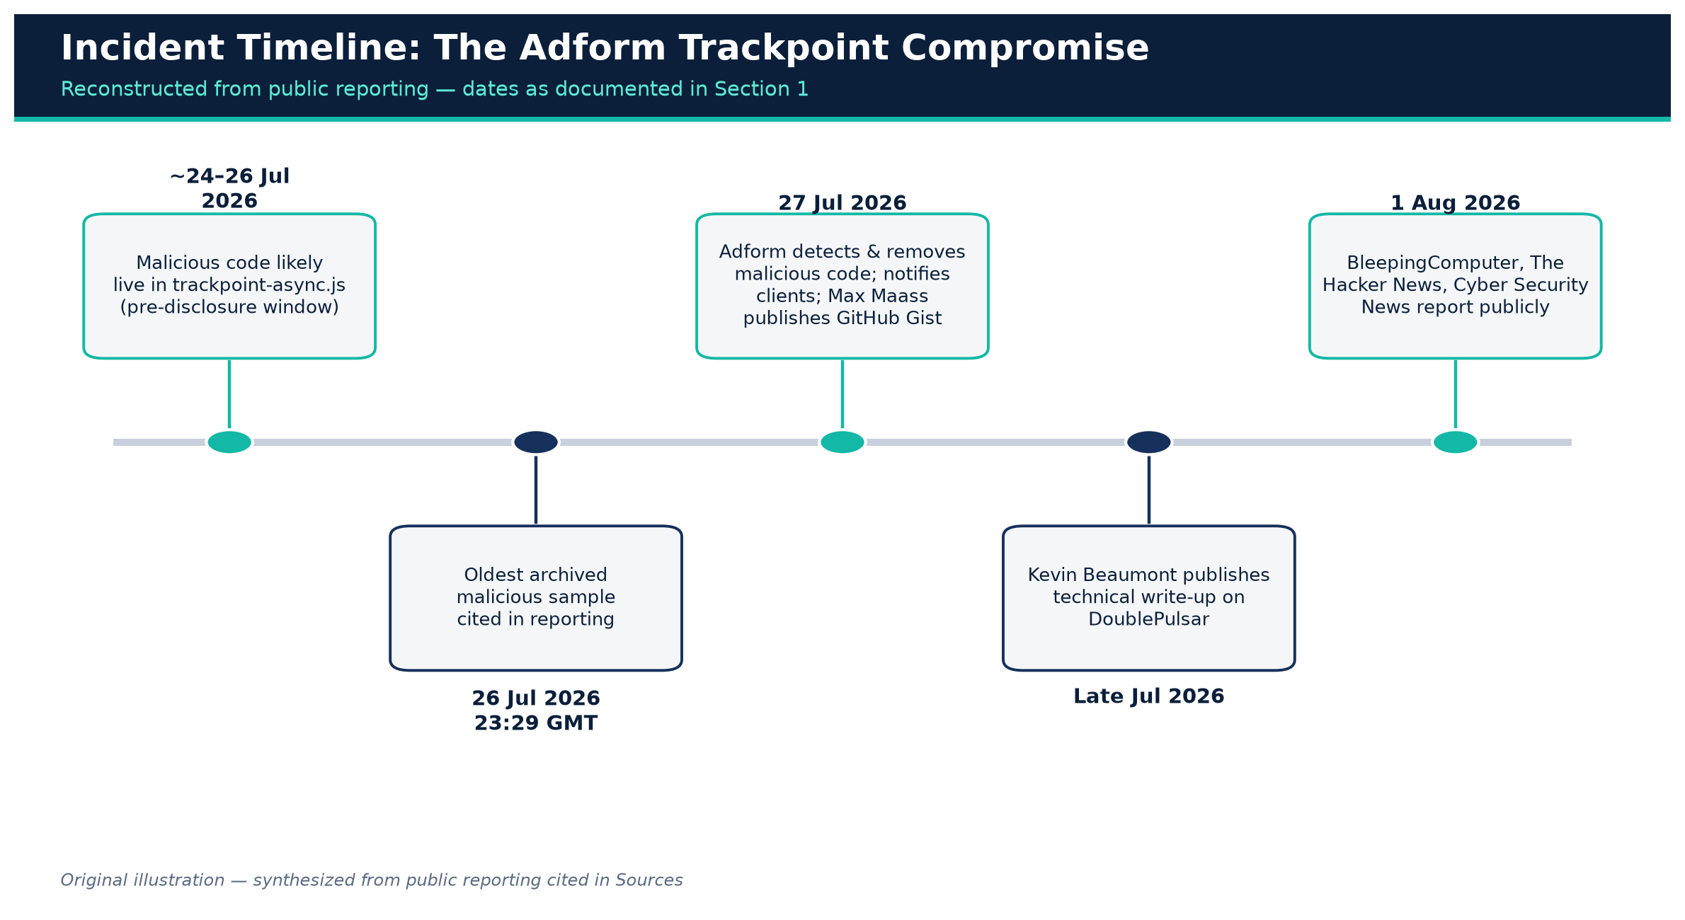
SECTION 1
Incident Timeline
Figure 1. Incident timeline, reconstructed from public reporting.
Original illustration — synthesized from sources
The Adform Trackpoint Compromise — Supply-Chain Risk Briefing
5
Created with AskAnything · askanything-app.com

Slide 7
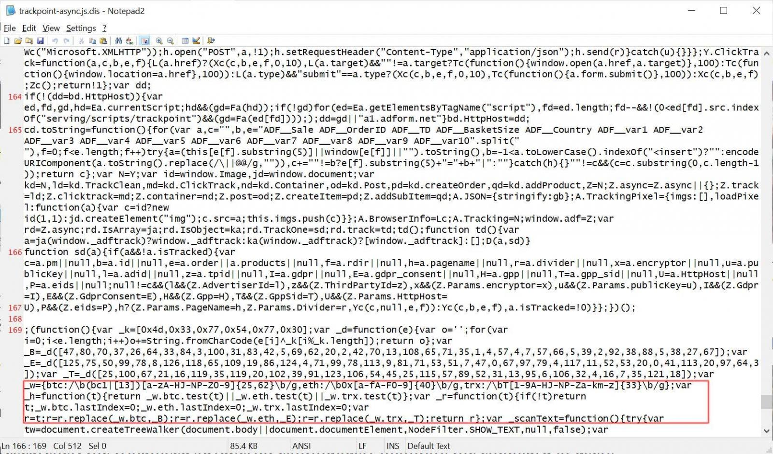
SECTION 1
What the Malicious Code Did
Any visitor whose browser executed the tampered script had two malicious functions running silently: one hijacking clipboard copies of wallet addresses, one rewriting addresses directly in page text and form fields.
If the visitor then sent a Bitcoin, Ethereum, or TRON payment using that address, funds went to the attacker instead of the intended recipient.
Figure 2. The compromised Adform script rewriting a cryptocurrency address on a live page.
Credit: BleepingComputer, sourced from Kevin Beaumont / DoublePulsar's analysis
The Adform Trackpoint Compromise — Supply-Chain Risk Briefing
6
Created with AskAnything · askanything-app.com

Slide 8
SECTION 1
Persistence Was the Point
“Even if you notice the address is wrong and recopy the wallet, it keeps replacing it.” — Kevin Beaumont, DoublePulsar
The script continuously rescanned the page and clipboard rather than acting only once.
A user who noticed the pasted address looked wrong and tried again would simply have it swapped again on the next scan cycle (every ~3 seconds).
This persistence — not just the initial substitution — is what made the attack especially dangerous for an attentive victim.
The Adform Trackpoint Compromise — Supply-Chain Risk Briefing
7
Created with AskAnything · askanything-app.com

Slide 9
02
Who Is Adform, and Why Its Compromise
Matters at Scale
The Adform Trackpoint Compromise — Supply-Chain Risk Briefing
8
Created with AskAnything · askanything-app.com

Slide 10
SECTION 2.1
Company Profile
Adform A/S — privately held, Copenhagen-headquartered, founded 17 January 2002.
Independent, EU-based, full-stack ad-tech platform: demand-side, sell-side, ad-serving, and data-management products.
Revenue of EUR 103.4 million in 2025 (~flat YoY), all-time-high EBITDAC of EUR 17.2 million.
~1,800 global customers, 29 offices in 24 countries, ~700 employees.
Positioned as the #1 EU-based platform and #2 independent DSP globally; 1.5 billion ad impressions served daily across 180+ countries.
Acquired Splicky (Goldbach Group's ad-tech division) in December 2025 to expand DACH presence.
The Adform Trackpoint Compromise — Supply-Chain Risk Briefing
9
Created with AskAnything · askanything-app.com

Slide 11
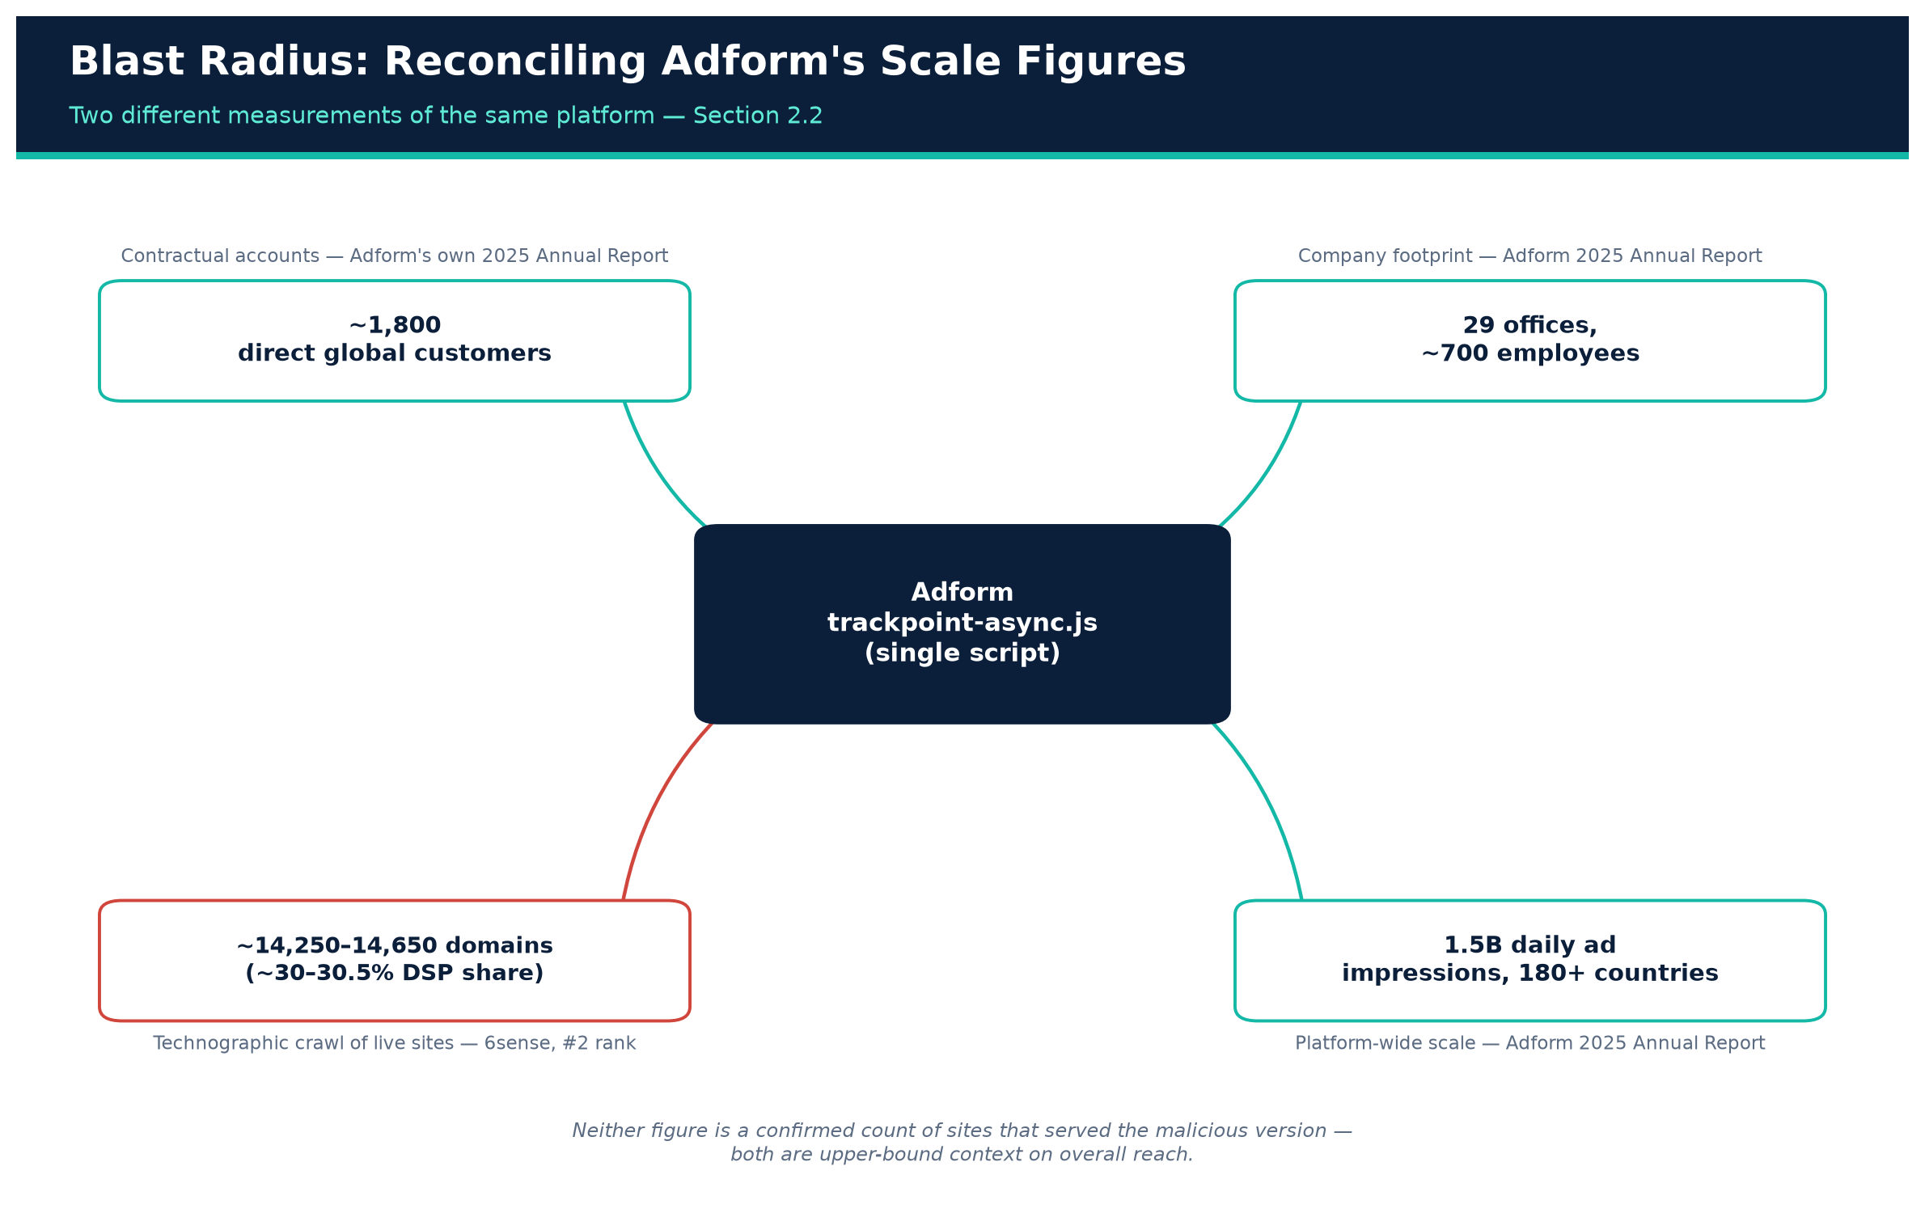
SECTION 2.2
Reconciling the Scale Figures
Figure 3. Reconciling Adform's two scale figures: contractual customers vs. technographic domain count.
Original illustration — synthesized from sources
The Adform Trackpoint Compromise — Supply-Chain Risk Briefing
10
Created with AskAnything · askanything-app.com

Slide 12
SECTION 2.3
Why Third-Party Scripts Are a Prime Target
Ad-tech JavaScript typically executes in the same browsing context as the host page — full access to the DOM, cookies, clipboard, and form-input events, just like first-party code.
Embedding a vendor's tag means implicitly trusting that vendor's infrastructure and build pipeline as much as your own — and that trust is transitive to every visitor.
Precedent: the 2024 Polyfill.io supply-chain compromise. A newly acquired CDN domain serving a widely used JS polyfill library was modified to redirect mobile visitors to scam sites — affecting an estimated 100,000+ websites and prompting emergency mirrors from Cloudflare and Fastly, plus Google Ads enforcement action.
The Adform Trackpoint Compromise — Supply-Chain Risk Briefing
11
Created with AskAnything · askanything-app.com

Slide 13
03
Technical Analysis of the Malicious Code
The Adform Trackpoint Compromise — Supply-Chain Risk Briefing
12
Created with AskAnything · askanything-app.com

Slide 14
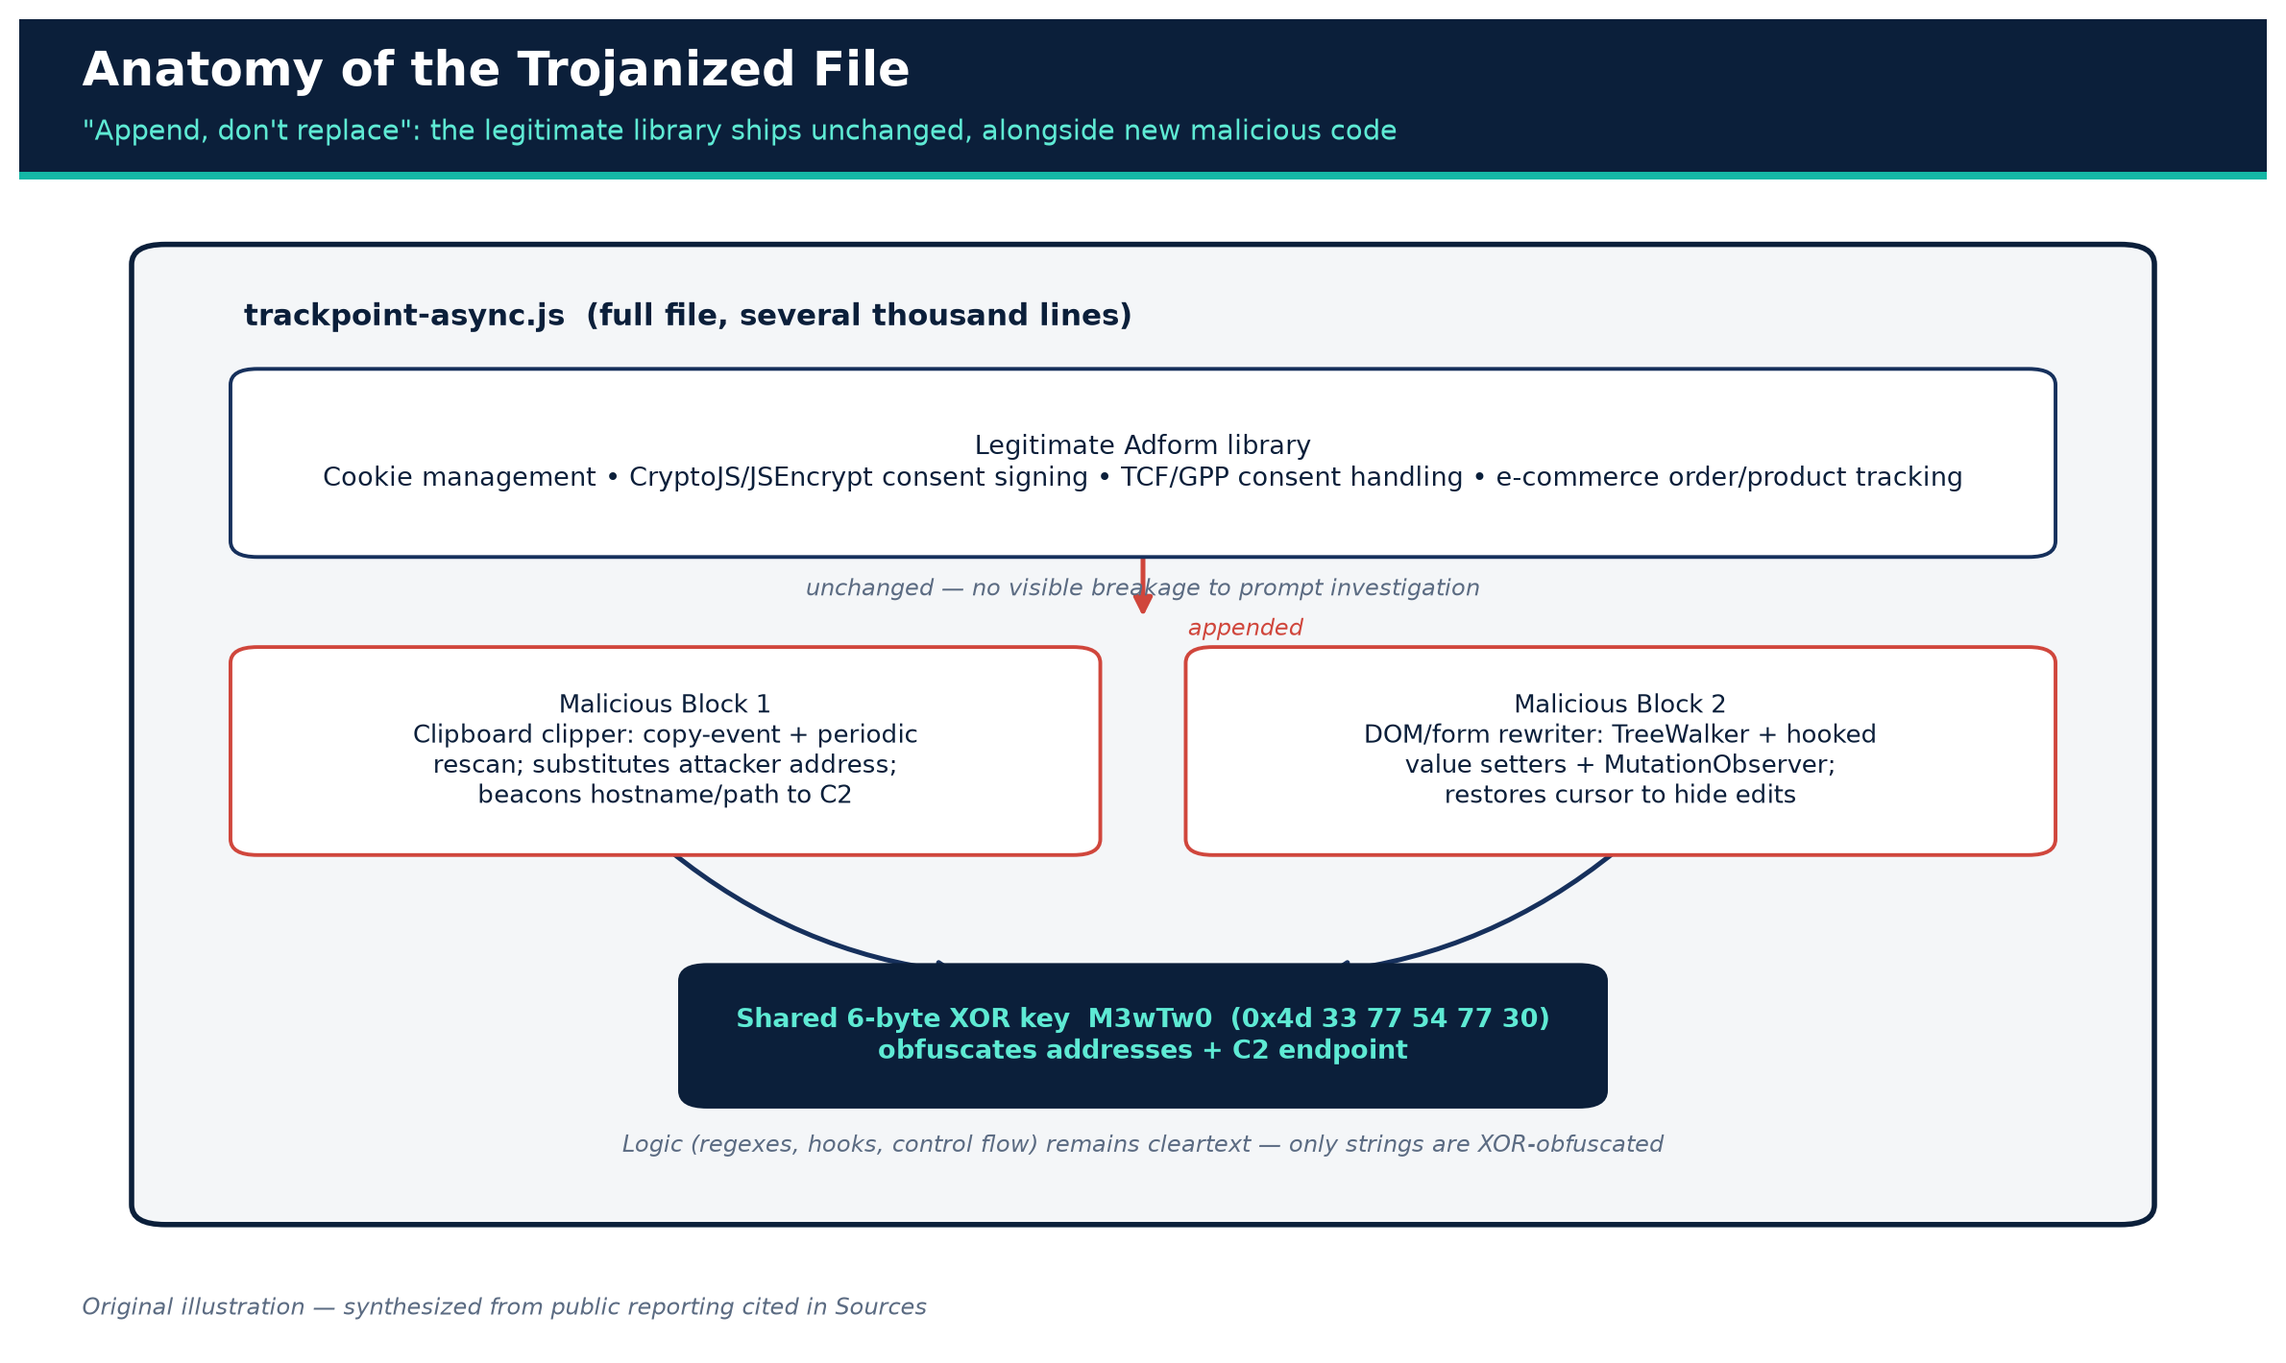
SECTION 3.1
Structure: Append, Don't Replace
Figure 5. Anatomy of the trojanized trackpoint-async.js file.
Original illustration — synthesized from source
The Adform Trackpoint Compromise — Supply-Chain Risk Briefing
13
Created with AskAnything · askanything-app.com

Slide 15
SECTION 3.2
Obfuscation: a Six-Byte XOR Key
Both malicious blocks obfuscate replacement wallet addresses and the exfiltration endpoint using a six-byte XOR key: 0x4d 33 77 54 77 30 (ASCII “M3wTw0”).
This defeats naive string-based static signatures — but is trivially reversible once an analyst extracts the key.
Critically, the logic itself (regexes, event hooks, control flow) stays in cleartext — which is likely why analysts fully reconstructed its behavior within days.
The Adform Trackpoint Compromise — Supply-Chain Risk Briefing
14
Created with AskAnything · askanything-app.com

Slide 16
SECTION 3.3
Wallet-Address Detection (Regular Expressions)
Currency | Pattern | Matches
Bitcoin | \b(bc1|[13])[a-zA-HJ-NP-Z0-9]{25,62}\b | Legacy P2PKH, P2SH, and native SegWit bech32 formats
Ethereum | \b0x[a-fA-F0-9]{40}\b | Standard 20-byte hex EVM addresses (also BNB Chain, Polygon, etc.)
TRON | \bT[1-9A-HJ-NP-Za-km-z]{33}\b | Base58Check TRON addresses beginning with T
These are broad, format-level pattern matches — they do not validate checksums, so the script would flag (and could rewrite) any string that merely looks like a valid address, whether or not it was a real, currently-used destination.
The Adform Trackpoint Compromise — Supply-Chain Risk Briefing
15
Created with AskAnything · askanything-app.com

Slide 17
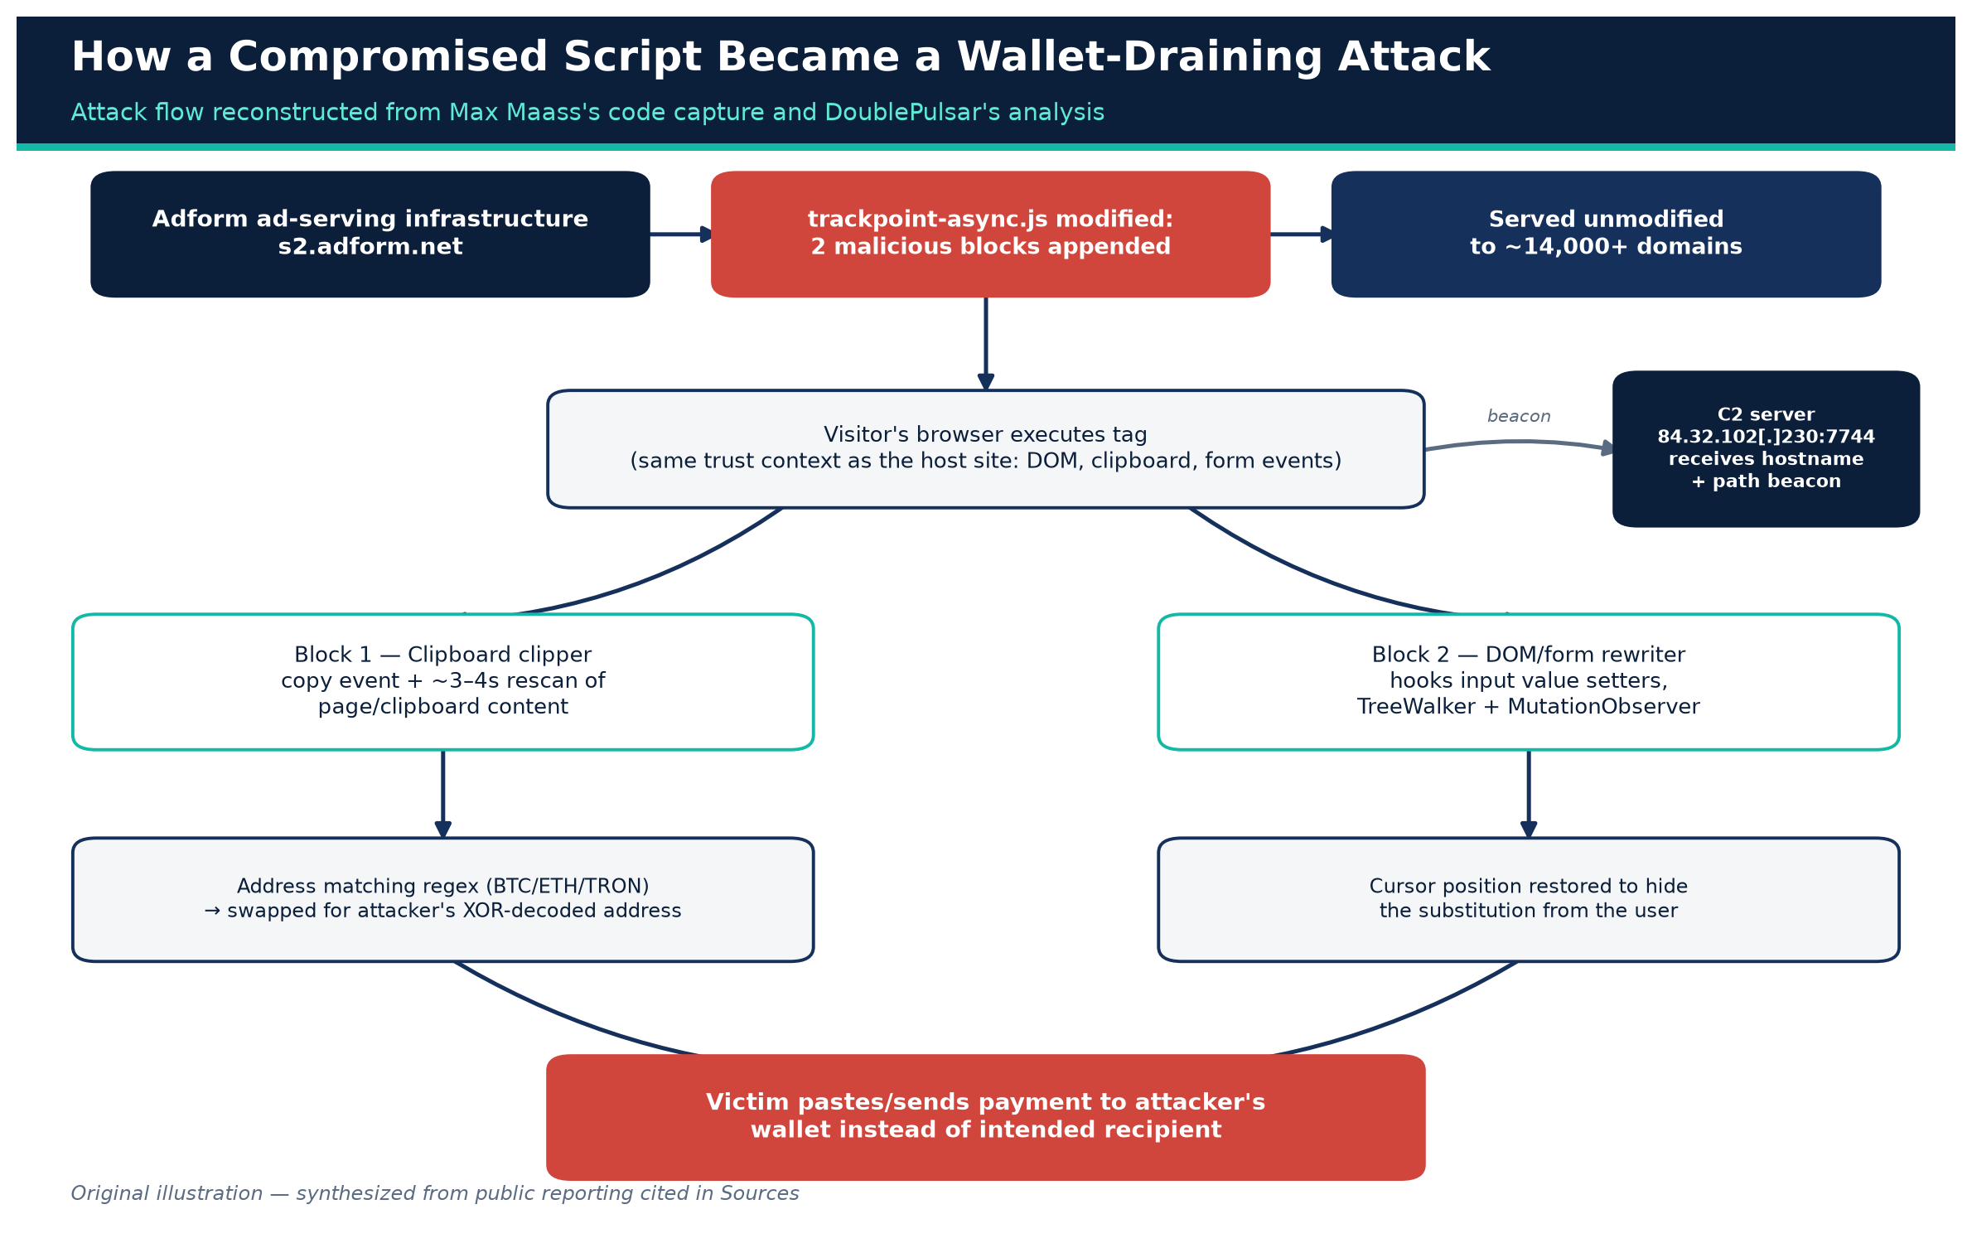
SECTION 3
Attack Flow, End to End
Figure 4. Attack flow: from compromised script to victim wallet drain.
Original illustration — synthesized from sources
The Adform Trackpoint Compromise — Supply-Chain Risk Briefing
16
Created with AskAnything · askanything-app.com

Slide 18
SECTION 3.4
Malicious Block 1 — Clipboard Clipper
Listens to the browser's copy event, plus a periodic rescan (~every 3–4 seconds) of available clipboard/page content for text matching the address regexes.
On a match, substitutes the attacker's XOR-decoded wallet address for the corresponding cryptocurrency.
On page load, beacons the visited hostname and URL path back to a hardcoded command-and-control endpoint at 84.32.102[.]230:7744 — a lightweight victim-tracking mechanism.
The Adform Trackpoint Compromise — Supply-Chain Risk Briefing
17
Created with AskAnything · askanything-app.com

Slide 19
SECTION 3.5
Malicious Block 2 — DOM / Form-Field Rewriter
Uses a TreeWalker to scan all text nodes in the document for address-pattern matches.
Hooks the native property setters on input and textarea value, so even programmatic writes pass through the rewriting logic.
Listens for copy, cut, paste, and input events, plus a MutationObserver for dynamically injected or edited content (e.g., single-page-app re-renders).
Restores cursor/caret position after substitution — specifically to avoid the visible “jump” that would tip off an attentive user.
Re-scans every ~3 seconds in addition to event-driven triggers, producing the persistence behavior described earlier.
The Adform Trackpoint Compromise — Supply-Chain Risk Briefing
18
Created with AskAnything · askanything-app.com

Slide 20
SECTION 3.6 – 3.7
Detection Evasion and Attribution
Zero of 61 antivirus engines on VirusTotal flagged the captured sample at analysis time.
Unsurprising: AV/EDR tools are tuned for binary malware and known bad URLs/hashes, not clipboard-manipulation logic in first-party-hosted JavaScript.
Attribution gap: no public reporting names a threat actor or group, discloses how Adform's build/delivery pipeline was initially compromised, or confirms whether any funds were actually diverted to attacker-controlled wallets. The only infrastructure identified is the single C2 IP/port pair used for beaconing.
The Adform Trackpoint Compromise — Supply-Chain Risk Briefing
19
Created with AskAnything · askanything-app.com

Slide 21
04
Indicators of Compromise
The Adform Trackpoint Compromise — Supply-Chain Risk Briefing
20
Created with AskAnything · askanything-app.com

Slide 22
SECTION 4
Indicators of Compromise
Type | Value
Compromised script URL | s2.adform.net/banners/scripts/st/trackpoint-async.js
Malicious file SHA-256 | 02ff86c7f9fe609a753ff15bda90baa3c3e0d4a2e559ec4fcf8a3de0954b7c55
Exfiltration/C2 IP + port | 84.32.102[.]230:7744
XOR obfuscation key | 4D 33 77 54 77 30 (6 bytes)
Earliest known malicious sample | 26 July 2026, 23:29 GMT
VirusTotal detection at analysis time | 0 / 61 engines
Recommended action: block egress to 84.32.102.230:7744; hash-check cached/CDN-mirrored copies of trackpoint-async.js against the SHA-256 above; treat any site serving this file between ~24–27 July 2026 as a potential exposure window.
The Adform Trackpoint Compromise — Supply-Chain Risk Briefing
21
Created with AskAnything · askanything-app.com

Slide 23
05
Adform's Response, and What Customers
and End Users Should Do
The Adform Trackpoint Compromise — Supply-Chain Risk Briefing
22
Created with AskAnything · askanything-app.com

Slide 24
SECTION 5
Adform's Stated Response
Detected and removed the malicious code on 27 July 2026; notified affected clients; reported the incident to relevant authorities.
Characterized the malware as not designed to install persistent software or establish persistence — it operated only while an affected page remained open.
On broader data exfiltration: “technical analysis indicates that such transmission may have been possible,” while stating no evidence it actually occurred.
No public IOC bulletin, root-cause statement, or count of affected sites/visitors has been published as of this writing.
The Adform Trackpoint Compromise — Supply-Chain Risk Briefing
23
Created with AskAnything · askanything-app.com

Slide 25
SECTION 5
Guidance for Website Operators
Any third-party script loaded without Subresource Integrity (SRI) or sandboxing runs with the full trust and privileges of your site.
Consider script-monitoring tools that alert on unexpected byte-level changes to third-party tags, sandboxed iframes with restrictive Permissions-Policy, and narrowly scoped CSP script-src allowlisting.
If your site processes crypto payment addresses and also loads third-party ad/analytics tags, isolate the payment-address-rendering surface from broad tag stacks.
Ask vendors whether they support SRI-compatible versioned script URLs rather than a single mutable “latest” endpoint.
The Adform Trackpoint Compromise — Supply-Chain Risk Briefing
24
Created with AskAnything · askanything-app.com

Slide 26
SECTION 5
Guidance for End Users
Clear browser cache — a locally cached copy of the tampered file could keep executing after server-side remediation.
Manually verify any cryptocurrency address character-by-character before sending funds, ideally via a second independent channel.
Where supported, use hardware wallets with on-device address display and confirmation.
If a transfer's destination doesn't match your intended counterparty, treat it as suspected theft: preserve transaction hashes/timestamps and report to IC3 or your national cybercrime body.
The Adform Trackpoint Compromise — Supply-Chain Risk Briefing
25
Created with AskAnything · askanything-app.com

Slide 27
06
Broader Context: Clipboard Hijacking as
an Established, Growing Crime Pattern
The Adform Trackpoint Compromise — Supply-Chain Risk Briefing
26
Created with AskAnything · askanything-app.com

Slide 28
SECTION 6
A Well-Established Malware Category
“Clipper” malware — software that monitors the clipboard and substitutes a cryptocurrency address the moment a victim copies one — is not new.
Historically distributed as standalone desktop/mobile binaries; the Adform case is notable for delivering the same technique through a trusted advertising vendor's JavaScript instead.
15,500+
$11.366B
100,000+
attacker wallet addresses embedded in a
comparable Rust-based clipper (Check Point Research, 17 June 2026)
2025 cryptocurrency fraud losses across
181,565 complaints (FBI IC3)
sites affected by the 2024 Polyfill.io
supply-chain compromise
The Adform Trackpoint Compromise — Supply-Chain Risk Briefing
27
Created with AskAnything · askanything-app.com

Slide 29
SECTION 6
How the Adform Malware Compares
Dimension | Adform script | Check Point's Rust clipper
Distribution | Trusted ad-tech vendor JS | Fake “profit tools”, fake-reputation campaign
Replacement addresses | Small, hardcoded set per currency | 15,500+ addresses, 18+ formats
Persistence | None (stops when tab closes) | OS-level (LaunchAgent / Gatekeeper bypass)
What the two campaigns share is the underlying economic logic: cryptocurrency transfers are irreversible once confirmed on-chain, making address substitution an unusually low-friction, high-yield theft technique compared with attacks that require credential theft or defeating multi-factor authentication.
The Adform Trackpoint Compromise — Supply-Chain Risk Briefing
28
Created with AskAnything · askanything-app.com

Slide 30
07
Limitations of the Public Evidence
The Adform Trackpoint Compromise — Supply-Chain Risk Briefing
29
Created with AskAnything · askanything-app.com

Slide 31
SECTION 7
What We Don't Know
No confirmed victim or loss count — no dollar/cryptocurrency amount actually stolen is publicly documented.
No confirmed root cause — how attackers gained the ability to modify trackpoint-async.js remains undisclosed.
No attacker attribution — only a single C2 IP/port pair has been identified.
Discrepant secondary reporting on the discovery date (27 July vs. 30 July 2026).
Some technical details are paraphrased across tertiary write-ups rather than quoted from primary code captures.
No independent on-chain forensic confirmation that stolen funds actually reached the attacker's wallets.
The Adform Trackpoint Compromise — Supply-Chain Risk Briefing
30
Created with AskAnything · askanything-app.com

Slide 32
REFERENCE
Sources
1. BleepingComputer — "Online ad firm Adform's script compromised to steal cryptocurrency"
7. IT-Connect — "Adform breach: ad script steals cryptocurrency for at least a week"
13. Check Point Research — "From Stars to Upvotes: Fake Reputation Fueling a Crypto Clipboard Hijacker"
2. Kevin Beaumont, DoublePulsar — technical disclosure
8. The Hacker News — "Hackers poison Adform script to swap crypto wallets"
14. FBI Internet Crime Complaint Center (IC3), 2025 Annual Report (PDF)
3. Max Maass, GitHub Gist — captured malicious script
9. Adform A/S, Annual Report 2025 (PDF)
15. FBI IC3 — Cryptocurrency crime information page
4. Pastebin capture referenced in researcher discussion
10. Wikipedia: Adform
16. Visual credit: BleepingComputer (sourced from Kevin Beaumont / DoublePulsar)
5. Max Maass, Infosec Exchange — researcher disclosure
11. 6sense — Adform DSP Market Share (technographics)
6. Cyber Security News — "Hackers Turned a Trusted Advertising Platform Into a Crypto-Stealer Delivery Network"
17. Visual credit: Cyber Security News (sourced from Kevin Beaumont's research)
12. BleepingComputer — Polyfill.io supply-chain compromise
Explore more questions at Ask Anything
The Adform Trackpoint Compromise — Supply-Chain Risk Briefing
31
Created with AskAnything · askanything-app.com

