Slide 1
DEFENDER TECHNICAL REPORT
The Keyv/Cacheable npm Worm:
A Confirmed “Mini Shai-Hulud” Descendant
That Backdoors Claude Code and VS Code
A compromised maintainer account triggered a self-propagating npm worm with an unseizable Ethereum C2 channel and, for the first time, persistence hooks committed straight into AI coding-agent and editor configuration.
August 2026 incident — Ask Anything analysis
Created with AskAnything - askanything-app.com
Created with AskAnything · askanything-app.com

Slide 2
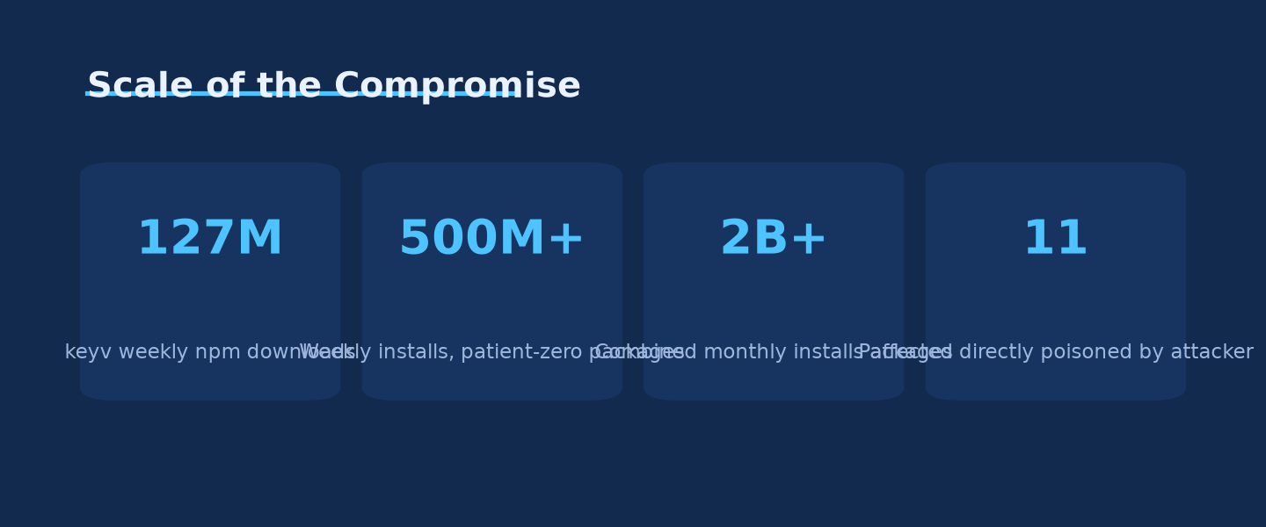
SCALE OF THE COMPROMISE
This began as one maintainer account and became a two-billion-install exposure
500M+
weekly installs across the 11 “patient zero” packages, before any worm propagation began
2B+
combined monthly installs across all poisoned package versions after propagation
9+
downstream npm organizations confirmed swept into propagation
Source: Wiz, 2026; JFrog Security Research, 2026; Datadog Security Labs, 2026 — chart: Ask Anything analysis
Created with AskAnything - askanything-app.com
Created with AskAnything · askanything-app.com
Notes:
The keyv maintainer's packages alone carry over 500 million weekly downloads before the worm ever propagated. Once it activated, cross-vendor trackers converged on a combined footprint exceeding two billion monthly installs. This is the scale context defenders need before triaging: this is not a niche package.

Slide 3
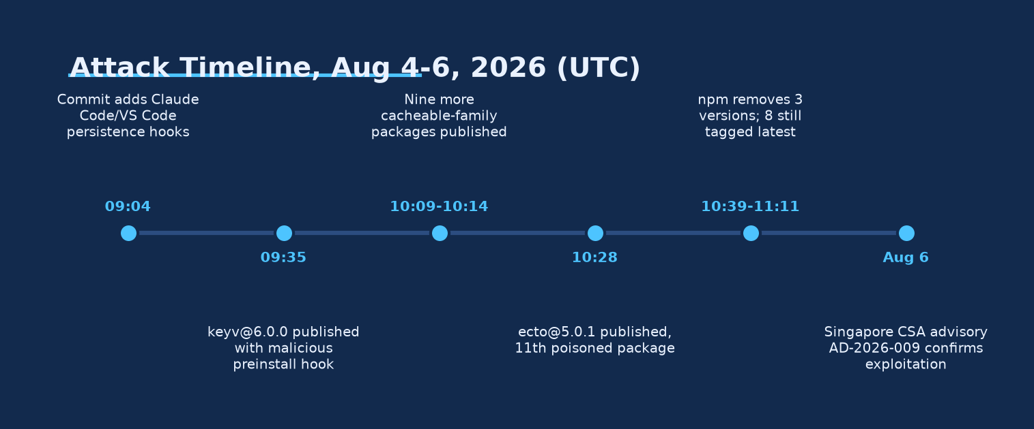
ATTACK TIMELINE
From a stolen GitHub account to global npm propagation in under two hours
Source: Snyk, 2026; Aikido, 2026 — timeline reconstructed from GitHub commit and npm publish timestamps, Aug 4–6, 2026 (UTC)
Created with AskAnything - askanything-app.com
Created with AskAnything · askanything-app.com
Notes:
The attacker committed the persistence hooks and lifecycle-script payload directly to the keyv repository between 09:02 and 09:23 UTC, then published the first poisoned release at 09:35. Within three hours, community researchers and npm itself were reacting, but propagation to hundreds of other packages was already underway.

Slide 4
ROOT CAUSE
Four individually reasonable defaults compound into one exploitable stack
A
B
C
D
Lifecycle scripts
run pre-review
Provenance proves
origin, not trust
2FA-bypass tokens
are skeleton keys
Agent/editor configs
are unreviewed exec surface
npm's preinstall/postinstall hooks execute the instant a package installs — before any human imports or reviews the code.
Sigstore/SLSA attestation cryptographically proves which pipeline built the artifact — not whether the source repo was trustworthy.
Tokens with bypass_2fa=true and write access — built for CI convenience — become a master key the moment they're stolen.
Committed .claude/settings.json and .vscode/tasks.json files run code on session start — a surface security tooling doesn't scan.
Source: Snyk, 2026; JFrog Security Research, 2026; GitHub Changelog, 2026-07-08
Created with AskAnything - askanything-app.com
Created with AskAnything · askanything-app.com
Notes:
None of these four decisions is unreasonable on its own — lifecycle scripts support native builds, provenance is a genuine anti-tampering control, 2FA-bypass tokens serve legitimate CI needs, and project config files are meant to be convenient. Together they form an unbroken chain from compromised credential to remote code execution on any machine that clones the repo.

Slide 5
NOVEL MECHANISM
A short remediation checklist is not a small blast radius
WHAT TEAMS ASSUME FIXES IT
WHAT ACTUALLY PERSISTS
Rotate leaked credentials
.claude/settings.json (SessionStart hook)
.vscode/tasks.json (runOn: folderOpen)
npm uninstall / reinstall clean version
Both are committed to the source tree, not installed by npm. They survive rm -rf node_modules, npm ci, credential rotation, and a full machine rebuild — the trigger simply reappears the next time anyone clones the repo and opens it in Claude Code or VS Code.
Wipe and rebuild the workstation
✗
None of these remove a hook already committed to git history
Source: hard2bit, 2026; Wiz, 2026; Datadog Security Labs — “Before the first prompt,” 2026
Created with AskAnything - askanything-app.com
Created with AskAnything · askanything-app.com
Notes:
This is the most distinctive element of the August wave: prior remediation playbooks assumed the compromise lived in node_modules or in leaked credentials. Because the hooks are committed to the git tree itself, standard incident response steps don't remove them — the repository has to be inspected and cleaned directly.

Slide 6
MALWARE ARCHITECTURE
One preinstall hook triggers a six-stage kill chain
1
2
3
4
5
6
Delivery
Main payload
Credential
harvesting
Exfiltration
C2
Propagation
preinstall runs setup.mjs, silently fetches Bun 1.3.13
~720KB obfuscated 2nd stage, self-relaunches detached
npm/cloud/SSH/Vault/AI-tool tokens, /etc/shadow
AES-256-GCM + RSA wrap; public GitHub dead-drop fallback
Ethereum eth_call resolves current C2 domain, then eval
stolen tokens republish payload into every writable package
Source: JFrog Security Research, 2026; Upwind, 2026; Snyk, 2026
Once a C2 response containing a code field is received, it is executed via eval — giving the operator full remote code execution inside the already-compromised process. The credential harvester alone checks several hundred filesystem glob patterns spanning cloud, CI, VPN, and AI-tool credentials.
Created with AskAnything - askanything-app.com
Created with AskAnything · askanything-app.com
Notes:
This is the defensive-relevant summary of the payload, deliberately omitting the obfuscation cipher and C2 protocol details. The chain runs end-to-end automatically: a developer only has to run npm install once for all six stages to execute in sequence.

Slide 7
C2 RESILIENCE
An Ethereum smart contract makes domain takedown obsolete
TRADITIONAL C2
THIS WORM'S C2
Malware hardcodes a C2 domain or IP
Registrar or hosting provider seizes/suspends it
Campaign loses its command channel
Operator must re-infect hosts with new infrastructure pointer
Malware calls eth_call on Ethereum mainnet contract 0xE1f2...93103
Contract's stored string decodes to the live C2 domain
Domain seizure doesn't touch the contract
Operator updates the contract's return value — campaign continues uninterrupted
✗
✓
Source: Upwind, 2026; Wiz, 2026; JFrog Security Research, 2026
Created with AskAnything - askanything-app.com
Created with AskAnything · askanything-app.com
Notes:
This EtherHiding-style technique stores the attacker's infrastructure pointer in immutable, censorship-resistant blockchain state rather than DNS. Supporting RPC endpoints observed include eth-mainnet.nodereal.io, go.getblock.io, and eth.llamarpc.com — all unusual traffic for a JavaScript build pipeline and therefore a high-signal detection opportunity.

Slide 8
SELF-PROPAGATION
One stolen token turns every package it can write to into the next wave
Harvest npm token
Validate:
bypass_2fa + write access
For each writable
package: inject payload
Bump patch version,
republish via PUT
2–7 min
~30 min
50
typical propagation time between organizations
for a full cross-organization publishing cycle to complete
branches per repo the malware pushes to via stolen GitHub tokens
Source: JFrog Security Research, 2026; Aikido, 2026
Created with AskAnything - askanything-app.com
Created with AskAnything · askanything-app.com
Notes:
JFrog summarizes the effect precisely: one stolen npm token with broad write access can turn every package owned by that publisher into the next wave. Socket.dev's telemetry measured propagation moving between organizations roughly every two to seven minutes.

Slide 9
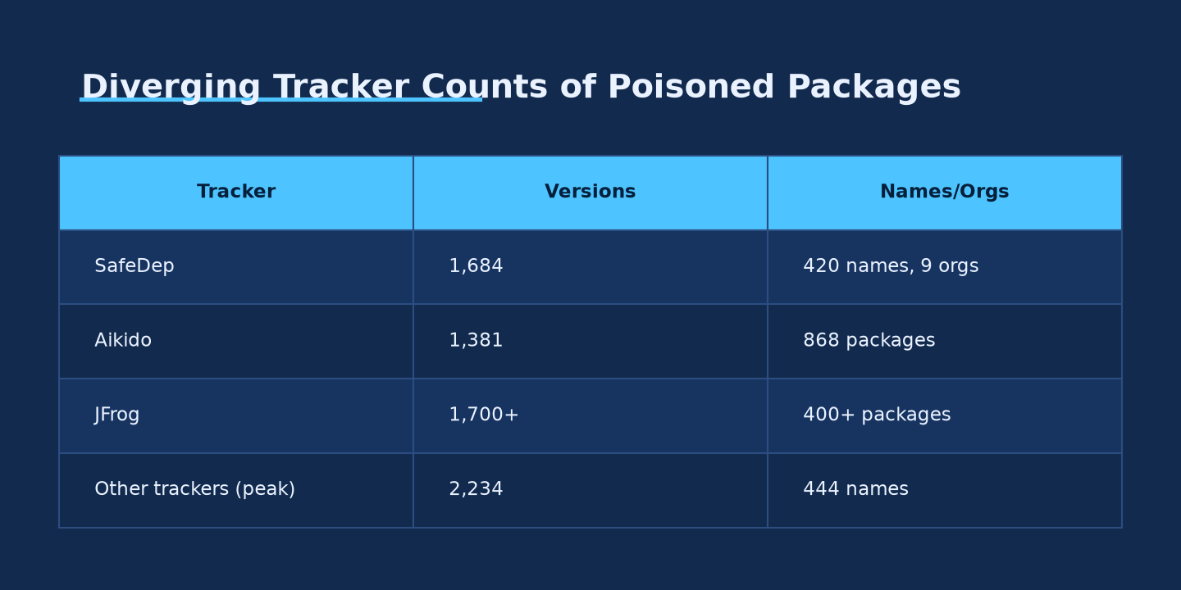
TRACKER DIVERGENCE
Nobody agrees on the final count — and that itself is the signal
Source: SafeDep, 2026; Aikido, 2026; JFrog Security Research, 2026 — figures are snapshots at each tracker's publication time, not final tallies
Created with AskAnything - askanything-app.com
Created with AskAnything · askanything-app.com
Notes:
Tracker counts range from roughly 400 to over 2,200 poisoned versions across several hundred package names. Treat any single number in this report as a lower bound at that timestamp, not a final count — the count was still climbing when each source published.

Slide 10
PATIENT ZERO
Eleven packages, one compromised account, 500M+ weekly installs
Package
Malicious
Clean / rollback
~Monthly DL
keyv
6.0.0
5.6.0
604–620M
flat-cache
6.1.24
6.1.23
580M
file-entry-cache
11.1.6/.7
11.1.5
571M
cacheable-request
13.0.20
13.0.19
137M
cacheable
2.5.1
2.5.0
30M
cache-manager
7.2.10
7.2.9
16M
ecto
5.0.1
5.0.0
4.5K
Source: Kodem Security, 2026; Snyk, 2026; Socket.dev, 2026; Datadog Security Labs, 2026
Created with AskAnything - askanything-app.com
Created with AskAnything · askanything-app.com
Notes:
All eleven packages share the same maintainer account and were published within roughly one hour of each other with byte-identical payload files, indicating a single injection process rather than independent compromises. Full matrix of eleven packages is in the underlying report; the four smallest by download volume are omitted here for space.

Slide 11
GENEALOGY
This is the fourth generation of Shai-Hulud, and the most persistent yet
Sept 2025
Nov 2025
May 2026
Aug 2026
Original
Shai-Hulud
Shai-Hulud 2.0
Mini Shai-Hulud /
TeamPCP (TanStack)
keyv/cacheable
(“ChainDrop”)
First self-propagating worm via stolen npm tokens
Moved trigger to pre-install; ~25,000 malicious repos
First wave with valid SLSA provenance via OIDC “pwn request”
Ethereum smart-contract C2 + first IDE/agent persistence hooks
Source: ReversingLabs, 2025; Datadog Security Labs, 2026; StepSecurity, 2026; Wiz, 2026
Created with AskAnything - askanything-app.com
Created with AskAnything · askanything-app.com
Notes:
Several outlets refer to the August wave by the alternate vendor name ChainDrop; this is a naming variant for the same campaign Wiz and JFrog describe as a Mini Shai-Hulud descendant, not a separate incident. Each wave used distinct filenames and hashes — do not merge blocklists across waves.

Slide 12
IN THE WILD
Evidence of active exploitation is unusually well corroborated
✓
GitHub dead-drops
546–1,300 public repos with description “Shai-Hulud: Here We Go Again” — anyone can search and verify this
✓
npm's own response log
3 malicious versions removed 10:39–11:11 UTC; 8 still tagged latest at 11:16 UTC
✓
Named organizations
Deliveroo, Qlik, Picsart, OneReach, and ServiceTitan scoped packages confirmed swept in
✓
Government advisory
Singapore CSA (AD-2026-009) confirms active exploitation, Aug 6, 2026
✓
Cross-vendor convergence
JFrog, Wiz, Aikido, Snyk, SafeDep, Socket.dev independently matched file hashes within 24–48 hours
Source: JFrog Security Research, 2026; Snyk, 2026; DevOps.com, 2026; CSA Singapore, 2026
Created with AskAnything - askanything-app.com
Created with AskAnything · askanything-app.com
Notes:
What is not independently verifiable: the true number of machines that executed the payload versus merely had it present in a lockfile, the volume of exfiltrated data, and whether any specific downstream breach resulted. Attribution to a named threat actor also remains unresolved.

Slide 13
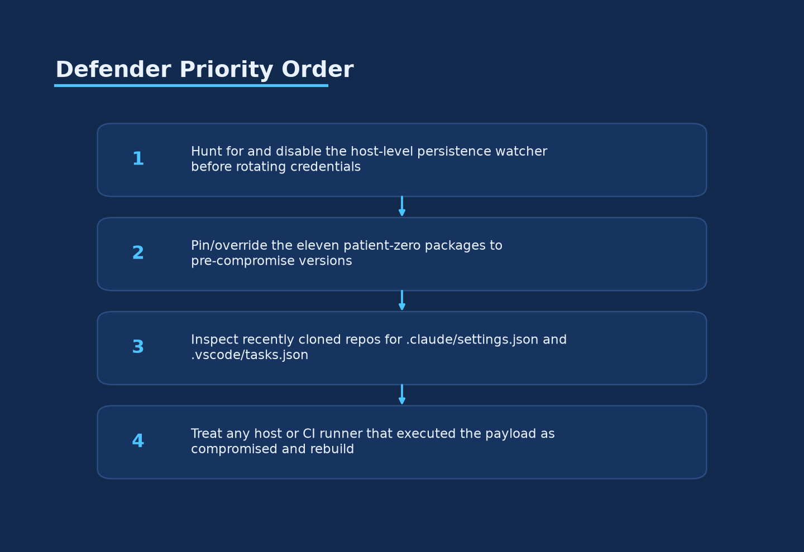
DEFENDER PRIORITY ORDER
Rotating credentials first can trigger the attacker's dead-man's switch
Source: SafeDep, 2026; JFrog Security Research, 2026 — chart: Ask Anything analysis
Created with AskAnything - askanything-app.com
Created with AskAnything · askanything-app.com
Notes:
A separate persistence component, gh-token-monitor, polls stolen GitHub tokens roughly every 60 seconds and executes a local handler if a token is detected as revoked. SafeDep's guidance is explicit: revocation is the watcher's trigger, so responders must locate and disable it before rotating credentials.

Slide 14
DETECTION GUIDANCE
Three signal classes catch this worm without executing anything
File & hash indicators
Network indicators
Git/GitHub signals
setup.mjs SHA-256 matches
npm-cache[.]com, pypi-get[.]com, js-mirror[.]com
New public repos titled “Shai-Hulud: Here We Go Again”
Math_Symbol.js / math_init.js (727,680 bytes)
Outbound eth_call to Ethereum RPC providers
Commits “chore: update config” forging a claude co-author
grep for SessionStart / runOn:folderOpen
Bun/1.3.13 user-agent with no declared Bun dependency
Pushes across up to 50 branches, skipping dependabot/copilot
Source: Snyk, 2026; JFrog Security Research, 2026; Wiz, 2026; MintMCP, 2026
Created with AskAnything - askanything-app.com
Created with AskAnything · askanything-app.com
Notes:
A GitHub 'verified' badge on a commit only confirms the signing path was valid — it does not confirm the human behind the account authorized the change. Treat 'verified' and 'authorized' as separate claims during investigation.

Slide 15
HARDENING
Treat .claude/ and .vscode/ as untrusted executable surface, not config
OLD ASSUMPTION
REQUIRED POSTURE
Project config files are inert settings
node_modules is the only executable surface worth scanning
A workspace-trust prompt is a habitual click-through
Credential rotation is always the first response step
Inspect .claude/settings.json and .vscode/tasks.json before opening any cloned repo
Enable allowManagedHooksOnly to block repo-committed hooks entirely
Treat the trust prompt as a genuine security decision
Hunt and disable persistence before rotating any credential
Source: Datadog Security Labs — “Before the first prompt,” 2026; Chainguard, 2026
Created with AskAnything - askanything-app.com
Created with AskAnything · askanything-app.com
Notes:
This is a durable posture change, not just an incident-specific check — the same review discipline applies to any externally sourced repository, given documented pre-trust execution issues found separately in Claude Code's hook system (CVE-2025-59536).

Slide 16
DECISION FRAMEWORK
Four conditions determine what your organization must do this week
If your lockfile resolves
any patient-zero package
Treat every host/runner that ran an install since Aug 4, 09:35 UTC as potentially compromised; run the priority order in slide 13
If you use Claude Code or
VS Code on external repos
Treat .claude/ and .vscode/ as untrusted executable surface by default — a durable posture, not a one-time check
If CI still runs
lifecycle scripts by default
Prioritize the npm 12 upgrade / --ignore-scripts change over almost any other single control
If you publish npm packages
Audit for bypass_2fa tokens; migrate to OIDC trusted publishing ahead of npm's Jan 2027 deadline
Source: Practical synthesis, Ask Anything report — derived from Socket.dev, 2026 and GitHub Changelog, 2026-07-08
Created with AskAnything - askanything-app.com
Created with AskAnything · askanything-app.com
Notes:
This incident applies to essentially any organization running Node.js-based CI/CD, since keyv and its siblings sit as deep transitive dependencies under widely used tooling, including reported transitive inclusion via ESLint's dependency chain.

Slide 17
RECOMMENDATION
Neutralize persistence first, then rotate, then close the systemic gaps
NOW (0–24h)
DAYS
WEEKS–MONTHS
Hunt gh-token-monitor persistence; pin/override the 11 patient-zero packages; reinstall with --ignore-scripts
Inspect recently cloned repos for committed hooks; rotate credentials from a clean host; rebuild any confirmed-executed runner
Migrate off bypass_2fa publishing tokens to OIDC; add a scanning/cooldown gate in front of your registry mirror; constrain CI egress
Created with AskAnything - askanything-app.com
Created with AskAnything · askanything-app.com
Notes:
The single highest-leverage structural fix is closing the primary delivery mechanism: moving off lifecycle scripts that run by default and off 2FA-bypass publishing tokens, both of which are already becoming platform-enforced defaults through January 2027.

Slide 18
SOURCES
Key references
Wiz — keyv and cacheable npm Package Hijacked in Supply Chain Attack (2026)
JFrog Security Research — Major Shai-Hulud campaign strikes npm again (2026)
Snyk — Inside the keyv npm Supply Chain Compromise (2026)
SafeDep — keyv and cacheable npm compromise: 400+ packages (2026)
Datadog Security Labs — Before the first prompt (2026)
Upwind — Keyv Supply Chain Compromise: Ethereum Smart Contract C2 (2026)
CSA Singapore — Advisory AD-2026-009 (2026)
GitHub Changelog — npm install-time security and GAT bypass2fa deprecation (2026-07-08)
Explore more questions at Ask Anything
Created with AskAnything - askanything-app.com
Created with AskAnything · askanything-app.com
Notes:
Full source list of 38 references is available in the underlying written report; this slide surfaces the primary technical write-ups the analysis relies on most heavily.

