Slide 1
D E F E N D E R ' S T E C H N I C A L D E E P D I V E
The knaithe/KnYuan AI-Orchestrated Exploitation Campaign and the Apache Tomcat KEV Entry (CVE-2026-34486)
Separating verified vulnerability facts from a single-source AI-attack narrative — and what it actually means for patch priority and detection.
Created with AskAnything - askanything-app.com
Created with AskAnything · askanything-app.com

Slide 2
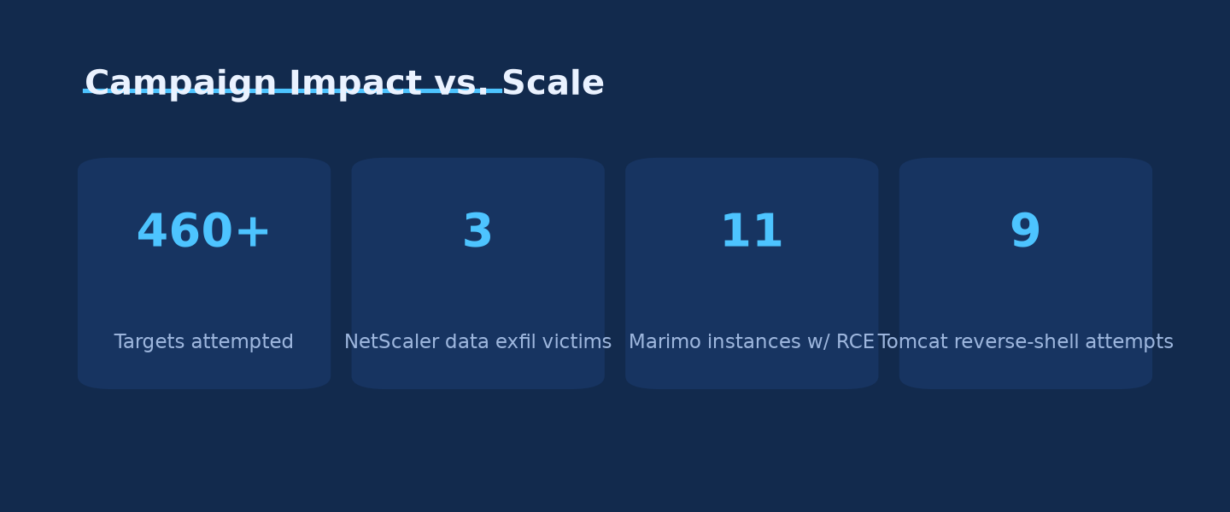
E X E C U T I V E S U M M A R Y
460+ targets made headlines — confirmed compromise is under 6% of that
460+
targets attempted, ≥3 countries
26
confirmed compromises across four CVEs
Unit 42's own reporting contains an unresolved gap between "three successfully exploited targets" and the sum of individually reported compromises (26+).
Source: Unit 42, 2026; BleepingComputer, 2026; GBHackers, 2026; The Hacker News, 2026
Created with AskAnything - askanything-app.com
Created with AskAnything · askanything-app.com
Notes:
The 460+ figure is a target/attempt count, not a confirmed-victim count. Confirmed impact is the sum of 3 NetScaler + 11 Marimo + 9 Tomcat + 3 Windows IKE = 26, roughly 5-6% of the headline number. The Hacker News explicitly flagged an internal inconsistency in Unit 42's reporting on the exact total and sought clarification that was never published.

Slide 3
C L A R I F Y I N G T H E R E C O R D
CISA added three CVEs to KEV on the same day — only one ties to this campaign
CVE-2026-34486
Apache Tomcat
Connected to the knaithe/KnYuan campaign — 9 reverse-shell attempts recorded against this CVE.
✓ IN SCOPE OF THIS REPORT
CVE-2026-9198
Langflow
A different Langflow bug than the one DeepSeek probed (fixed 1.10.1 vs. CVE-2026-33017's 1.9.0). Not evidence the campaign succeeded against Langflow.
UNRELATED VULNERABILITY
CVE-2026-18556/18577
N-able N-central
Authentication bypass in an unrelated vendor's remote monitoring platform — no link to knaithe/KnYuan or Tomcat.
UNRELATED VENDOR
All three were added to the KEV catalog on August 4, 2026, in the same weekly batch — three independent vulnerabilities, three independent vendors, not one chain.
Source: CISA, 2026; SecurityWeek, 2026
Created with AskAnything - askanything-app.com
Created with AskAnything · askanything-app.com
Notes:
A common misreading of the news cycle is to treat all three Aug 4 KEV additions as one story. They are not: only the Tomcat entry (CVE-2026-34486) is tied to the knaithe/KnYuan reporting. The Langflow KEV entry is a different bug than the one DeepSeek unsuccessfully probed, and N-able N-central is an entirely unrelated vendor.

Slide 4
A R C H I T E C T U R E
One human operator, one LLM, and an agent with no approval gate
Telegram
Operator issues high-level instructions (C2)
FOFA search
MCP-integrated recon; natural language → asset queries
DeepSeek
via Hermes Agent (“yolo” mode)
DeepSeek
via Hermes Agent (“yolo” mode)
Custom skills
“godmode” jailbreak bypass; web-terminal-exploitation
Proxy infrastructure
code.newcli.com masks Claude Code / Codex traffic
Autonomous phase: Langflow, n8n. Manual phase (operator-driven): NetScaler, Marimo, Tomcat, Windows IKE. Source: Unit 42, 2026
Created with AskAnything - askanything-app.com
Created with AskAnything · askanything-app.com
Notes:
Hermes Agent ran with human-in-the-loop approval gates removed. DeepSeek was the primary reasoning engine; secondary LLMs (Qwen, GLM, Kimi, MiniMax, Claude Code, OpenAI Codex) were configured but lightly used — Claude Code logged only 10 chat entries across three sessions, mostly for connectivity testing.

Slide 5
R O O T C A U S E
The patch for one Tomcat flaw introduced a worse one
BEFORE — CVE-2026-29146
Padding-oracle flaw
• EncryptInterceptor defaults to AES/CBC/PKCS5Padding
• Attacker distinguishes valid vs. invalid padding responses
• Iteratively decrypts ciphertext without ever holding the key
AFTER THE FIX — CVE-2026-34486
Fail-open regression
• Decryption failure is only logged, never discarded
• Raw, unencrypted attacker bytes forwarded to ObjectInputStream.readObject()
• No key needed at all — direct unauthenticated deserialization RCE
“The catch block only logs the error … the raw unencrypted bytes are forwarded to XByteBuffer.deserialize() → ObjectInputStream.readObject().” — Source: Apache Tomcat Security advisories; Field Effect, 2026
Created with AskAnything - askanything-app.com
Created with AskAnything · askanything-app.com
Notes:
This is a regression, not a new independent bug. Apache's own fix for the padding-oracle flaw (CVE-2026-29146) needed to discard undecryptable messages; the shipped code only logged the exception, so the raw bytes still reached ObjectInputStream.readObject() — a textbook unauthenticated Java deserialization sink.

Slide 6
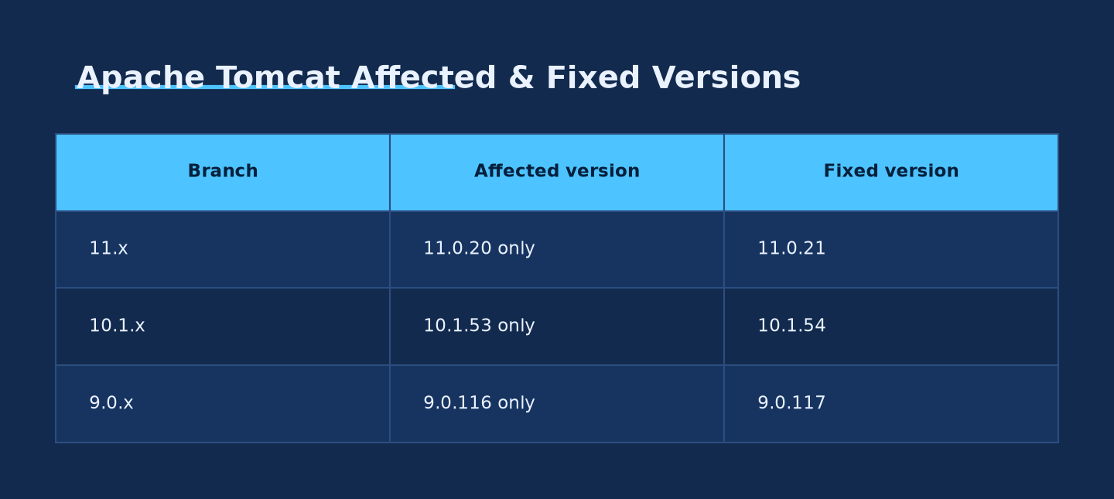
P A T C H S T A T U S
Patching CVE-2026-29146 is not enough — a second patch is required
Each branch's fix for the padding-oracle bug shipped exactly one regressed release. Fixed versions: 9.0.117 / 10.1.54 / 11.0.21.
Ask Anything analysis, generated from the report's cited data. Source: Apache Tomcat Security 9/10/11, 2026
Created with AskAnything - askanything-app.com
Created with AskAnything · askanything-app.com
Notes:
Teams that patched CVE-2026-29146 in April 2026 but landed on 9.0.116 / 10.1.53 / 11.0.20 are still vulnerable to CVE-2026-34486 and need the follow-on patch. Apache scopes each branch's 'affected' range narrowly to only the single release that shipped the broken fix.

Slide 7
S E V E R I T Y R E A L I T Y C H E C K
Tomcat scored lowest of the seven chained CVEs — and reached KEV anyway
CVE-2026-34486 — Apache Tomcat
THE OTHER SIX CVES IN THE CHAIN
7.5
CVSS 3.1 (AV:N/AC:L/PR:N/UI:N/S:U/C:H/I:N/A:N)
9.3–10.0
CVSS across Langflow, n8n ×2, NetScaler, Marimo, Windows IKE
Confidentiality-only score — the CVE is framed as an encryption bypass, not the RCE downstream PoCs demonstrate.
All six require no authentication — easier, more severe exploitation paths than the CVE that made headlines.
Source: NVD, CVE-2026-34486; Section 2 CVE table, this report
Created with AskAnything - askanything-app.com
Created with AskAnything · askanything-app.com
Notes:
CVSS and real-world severity diverge here. Defenders relying on CVSS alone to triage would significantly underrate CVE-2026-34486 relative to its demonstrated PoC impact — and would underrate the urgency of the other six, higher-scoring, unauthenticated CVEs in the same campaign.

Slide 8
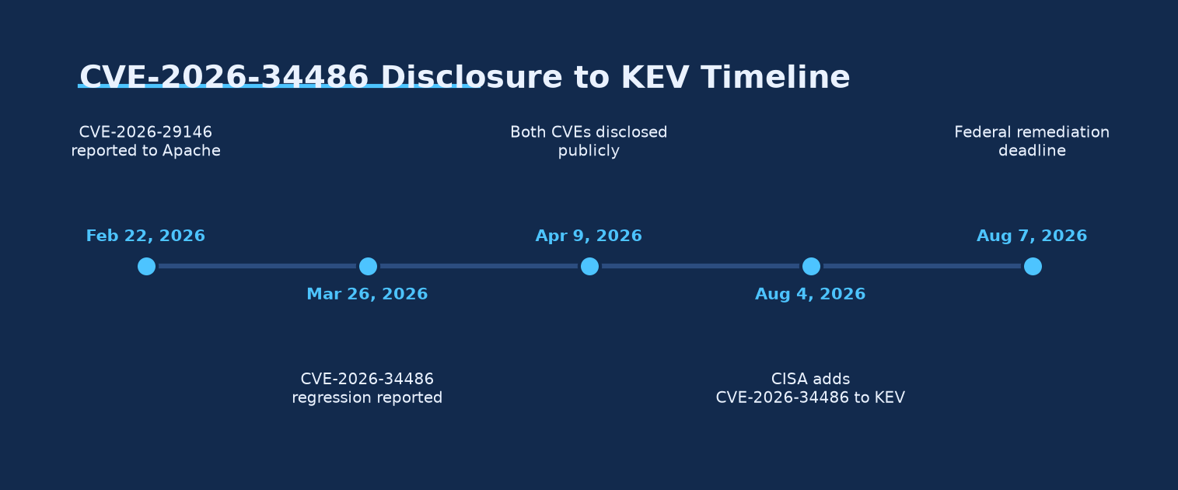
T I M E L I N E
A two-week regression window, then four months to a federal deadline
Mar 26 Reported to Apache
Apr 9 Publicly disclosed
Aug 4 Added to CISA KEV
Aug 7 Federal deadline
Ask Anything analysis, generated from the report's cited data. Source: Apache Tomcat Security advisories; CISA, 2026
Created with AskAnything - askanything-app.com
Created with AskAnything · askanything-app.com
Notes:
All dates in 2026. The regression window between the CVE-2026-29146 fix and the CVE-2026-34486 disclosure was short (about two weeks), but the resulting flaw was more severe than the bug it replaced.

Slide 9
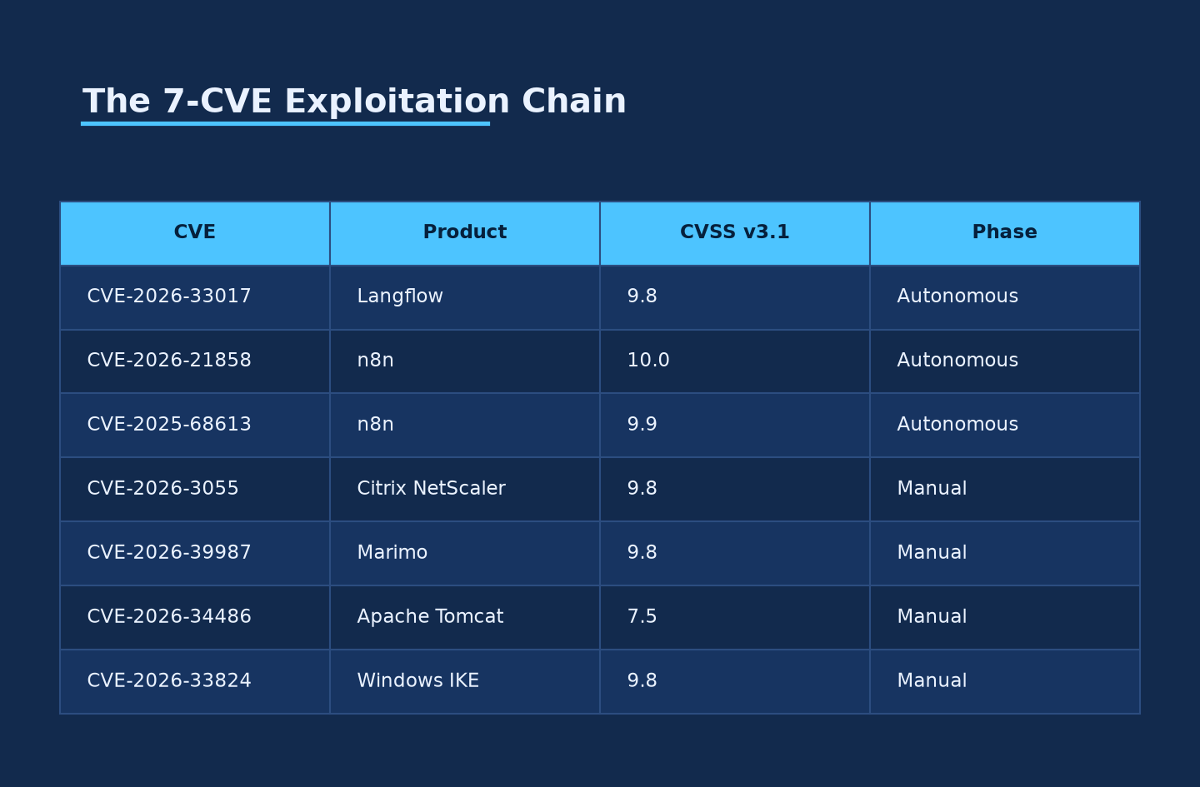
F U L L C H A I N
Seven CVEs, five products — six of them worse than the one that made headlines
Source: Unit 42, 2026; Apache/NVD/GitHub advisories (see Section 2 CVE table, this report)
Created with AskAnything - askanything-app.com
Created with AskAnything · askanything-app.com
Notes:
Langflow (CVE-2026-33017), two n8n bugs (CVE-2026-21858, CVE-2025-68613), Citrix NetScaler (CVE-2026-3055), Marimo (CVE-2026-39987), Apache Tomcat (CVE-2026-34486), and Windows IKE (CVE-2026-33824). The Langflow and n8n vectors ran in the largely autonomous phase; the rest were run manually by the operator.

Slide 10
I M P A C T B Y P R O D U C T
Confirmed compromise: 26 across four manually-exploited CVEs
3
11
9
3
Citrix NetScaler
data-exfiltration victims
Marimo
command-execution victims
Apache Tomcat
reverse-shell attempts
Windows IKE VPN
endpoints probed
Langflow and n8n exploitation ran in the autonomous phase. Unit 42 reports DeepSeek's Langflow attempts largely failed — assessed exploitability was ~0 across 84 enumerated instances due to restrictive auto_login configuration.
Source: Unit 42, 2026; BleepingComputer, 2026; GBHackers, 2026
Created with AskAnything - askanything-app.com
Created with AskAnything · askanything-app.com
Notes:
These four figures sum to 26 confirmed compromises against a reported 460+ target count. The n8n webhook sampling was throttled deliberately — only ~100 of 25,209 China-hosted instances were sampled.

Slide 11
H O W T H E O P E R A T I O N W A S E X P O S E D
A misconfigured file server on port 8888 handed researchers the toolchain
EXPOSED TO THE OPEN INTERNET
API keys · target lists · shell history · full agent session transcripts · tool configuration
python3 -m http.server 8888
run from the agent's own home directory
⚠ The caveat that matters for how much to trust this report
Most of what's publicly known about this campaign comes from the attacker's own exposed logs — not independent, victim-side forensic confirmation. Researchers reconstructed the toolchain from a self-inflicted OPSEC failure, not from defender telemetry.
Source: Unit 42, 2026; GBHackers, 2026
Created with AskAnything - askanything-app.com
Created with AskAnything · askanything-app.com
Notes:
This OPSEC failure is also a general lesson worth applying to your own authorized red-team infrastructure: an unexpected Python http.server instance on a non-standard working directory is exactly this kind of exposure.

Slide 12
E V I D E N C E Q U A L I T Y
Not all claims in this campaign rest on the same strength of evidence
STRONG
Vulnerability root cause, CVSS/CWE scores, KEV listing dates, and PoC existence — drawn from vendor advisories, NVD, and direct code review.
MODERATE
The knaithe/KnYuan toolchain, infrastructure, 460+ target figure, and per-CVE compromise counts — single primary source (Unit 42), echoed but not independently expanded by press.
DISPUTED
The exact "successfully exploited" total — Unit 42's own figure of three does not reconcile with the sum of individually cited compromises (26+); The Hacker News flagged this without a published resolution.
PRELIMINARY
DeepSeek's genuine autonomy vs. operator-directed prompting; any link to SNOWLIGHT/VShell; state attribution — none of these are independently verified.
Source: Evidence & caveats synthesis, this report
Created with AskAnything - askanything-app.com
Created with AskAnything · askanything-app.com
Notes:
Use this ladder to calibrate confidence per claim rather than treating the whole disclosure as uniformly certain. The vulnerability facts are rock-solid; the campaign narrative and scale figures rest on one vendor's disclosure.

Slide 13
P A R A L L E L T H R E A T
A second, unrelated actor exploited the same Tomcat flaw at far greater scale
knaithe / KnYuan
AI-orchestrated (this report's focus)
• DeepSeek + Hermes Agent, human-directed via Telegram
• 460+ targets across ≥3 countries
• Active into July–August 2026
SNOWLIGHT / VShell
UNC5174-linked toolkit
• curl|sh dropper, cracked Cobalt Strike, Sliver C2
• Government, healthcare, education — 100+ countries
• Active late April–early June 2026
SAME CVE-2026-34486
No confirmed operational link
Source: SoCRadar, 2026; The Hacker News, 2025; Sysdig, 2025
Created with AskAnything - askanything-app.com
Created with AskAnything · askanything-app.com
Notes:
No source reviewed claims these are the same operation — Unit 42's write-up does not mention SNOWLIGHT, VShell, or UNC5174. Two independent lines of evidence that the Tomcat CVE is being exploited is a stronger signal than either report alone, but it is not evidence of one unified campaign.

Slide 14
D E T E C T I O N R E A L I T Y
The exploit is loud at the network layer and silent everywhere else
Exploit attempt hits Tribes port
AES decryption fails
IllegalBlockSizeException logged
(noisy, low-precision)
Deserialization succeeds
No further Tomcat log artifact
Command execution is silent at the app layer
PRIMARY VIABLE CONTROL: HOST EDR / PROCESS-ANCESTRY TELEMETRY
Alert on any child process spawned by java (e.g., Tomcat's catalina.sh / org.apache.catalina.startup.Bootstrap) that invokes a shell — and on outbound connections from the Tomcat process to unexpected destinations.
Network indicator: any external/untrusted traffic to TCP 4000 is anomalous. Palo Alto's 8 NGFW signature IDs are proprietary and not portable to other IPS/IDS platforms.
Source: confirmed by independent technical write-ups of the PoC; Unit 42, 2026
Created with AskAnything - askanything-app.com
Created with AskAnything · askanything-app.com
Notes:
Once the gadget chain executes inside the JVM process, there is no additional servlet/access-log artifact. That makes host-based EDR the primary viable detection control for this specific CVE, not log analysis or network IDS alone.

Slide 15
I N T E R I M M I T I G A T I O N S
If you cannot patch today, cut network reachability to the Tribes port
1
Best mitigation: patch to 9.0.117 / 10.1.54 / 11.0.21 — closes both CVE-2026-34486 and CVE-2026-29146.
2
Restrict TCP 4000 at the network layer to only the specific internal IPs of other cluster nodes.
3
Disable clustering entirely if it isn't actively in use — many deployments inherit it from a template.
4
Do not rely on EncryptInterceptor as a mitigation — it is the very component this flaw bypasses.
5
Deploy a WAF/IPS rule blocking non-internal traffic to the Tribes port as a stopgap while patch testing completes.
Source: Section 5.1, this report
Created with AskAnything - askanything-app.com
Created with AskAnything · askanything-app.com
Notes:
Network-layer restriction of the Tribes port is the single highest-leverage compensating control — the vulnerability is entirely unreachable without network access to it.

Slide 16
D E C I S I O N F R A M E W O R K
A five-step blueprint for defenders, in priority order
1
2
3
4
5
Inventory first
Confirm whether Tomcat clustering is actually in use. If unused, disabling it removes the vulnerability entirely.
Patch the regression, specifically
Landing on 9.0.116 / 10.1.53 / 11.0.20 (the CVE-2026-29146 fix) still leaves you exposed to CVE-2026-34486.
Reprioritize the other six CVEs higher
Langflow, n8n ×2, NetScaler, Marimo, and Windows IKE score 9.3+ and need no authentication.
Instrument host-level detection
Log signature is weak; post-exploitation is silent at the application layer.
Don't over-index on the “AI” framing
Every technique here is a known n-day with public PoC — the defensive playbook is unchanged.
Source: Practical synthesis, this report
Created with AskAnything - askanything-app.com
Created with AskAnything · askanything-app.com
Notes:
This mirrors the report's Practical Synthesis section: inventory, patch precisely, reprioritize by real severity, instrument for silent post-exploitation, and keep the AI framing out of triage decisions.

Slide 17
B O T T O M L I N E
The technique isn't new. Neither is the defensive playbook.
Every CVE in this chain is a known n-day with public PoC code. Patch, restrict network exposure, and monitor process ancestry — the same actions sound vulnerability management already requires, regardless of whether a human or an LLM agent is driving the keyboard on the attacker's side.
WHAT TO MEASURE
• External exposure of Tribes/clustering ports across your Tomcat fleet
• Patch compliance against exact fixed versions, not just “latest Tomcat”
• EDR coverage and alert tuning for Java-process-spawns-shell patterns
• Time-to-patch vs. the CISA KEV deadline of August 7, 2026
Created with AskAnything - askanything-app.com
Created with AskAnything · askanything-app.com
Notes:
Close on the practical framing: the AI-orchestration angle is the newsworthy hook, but the defensive response is identical to standard vulnerability management discipline.

Slide 18
S O U R C E S
Primary references
• Unit 42, Palo Alto Networks (2026) — Chinese-Speaking Threat Actor Harnesses AI Models for Autonomous Cyberattacks
• CISA (2026) — CISA Adds Three Known Exploited Vulnerabilities to Catalog
• Apache Software Foundation (2026) — Tomcat 9/10/11 Security advisory pages
• NVD (2026) — CVE-2026-34486 detail record
• SecurityWeek (2026) — CISA Warns of Exploited Langflow, N-central, and Tomcat Vulnerabilities
• The Hacker News (2026) — Chinese Hacker Commands DeepSeek via Telegram to Launch Autonomous Attacks
• BleepingComputer (2026) — Hacker Uses DeepSeek AI to Autonomously Attack Vulnerable Servers
• SoCRadar (2026) — Tracing SNOWLIGHT: A Government-Targeted Chinese Campaign
Explore more questions at Ask Anything
Created with AskAnything - askanything-app.com
Created with AskAnything · askanything-app.com
Notes:
Full 52-source list is available in the underlying report (answer.md).

