Slide 1
SECURITY ADVISORY BRIEFING
VMSA-2026-0006: The Defender's Guide to the
Critical vCenter Auth-Bypass and
Syslog Directory-Traversal RCE
CVE-2026-59309 and CVE-2026-59310 are unauthenticated, CVSS 9.8 vCenter flaws with no workaround — patch is the only remediation, and the exploit mechanism is still undisclosed.
9.8
0
48-72 hrs
CVSS — both CVEs
Vendor workarounds
Since disclosure
Created with AskAnything - askanything-app.com
Created with AskAnything · askanything-app.com

Slide 2
EXECUTIVE SUMMARY
Two unauthenticated 9.8s give an attacker
the keys to the entire virtualization estate
!
!
!
CVE-2026-59309
CVE-2026-59310
Shared vector
vmdir Auth Bypass
Syslog Traversal -> RCE
AV:N/AC:L/PR:N/UI:N/S:U/
C:H/I:H/A:H
Bypass authentication on VMware
Directory Service (SSO backend) with
only network reachability.
Directory traversal in the Syslog
Server, described by Broadcom as
enabling arbitrary code execution.
No credentials. No user interaction.
Full compromise of confidentiality,
integrity, and availability.
Source: Broadcom Support Portal VMSA-2026-0006 (2026); NVD CVE-2026-59309 / CVE-2026-59310 (2026).
Created with AskAnything - askanything-app.com
2
Created with AskAnything · askanything-app.com
Notes:
VMSA-2026-0006 discloses five CVEs; two are critical, unauthenticated, network-exploitable vCenter flaws. Both share the identical worst-case CVSS vector. This is the frame for the whole deck: patch urgency without a disclosed exploitation mechanism.

Slide 3
ARCHITECTURE
vCenter is not one server -- it is the identity
and control plane for the whole estate
ESXi Hosts
VM Inventory
& Snapshots
vCenter
Server
RBAC / SSO
Identity
Datastores
A single foothold in vmdir compromises authentication and
authorization for every host, VM, and datastore the appliance
manages -- not just one guest.
Source: answer.md, "Why this advisory matters operationally," citing prior weaponized vCenter CVEs (CVE-2021-21985, CVE-2023-34048).
Created with AskAnything - askanything-app.com
3
Created with AskAnything · askanything-app.com
Notes:
Frame the blast radius before diving into the two CVEs. vCenter is the single pane of glass for an entire vSphere estate: RBAC, inventory, datastores, and every ESXi host it manages. Compromising vmdir compromises the identity and authorization plane, not a single VM.

Slide 4
CVE ANCHOR -- 59309
The vmdir bypass needs nothing but a
network path -- and the mechanism is secret
COMPONENT
CVSSv3.1 BASE SCORE
VMware Directory Service (vmdir)
9.8
CRITICAL
VENDOR DESCRIPTION
“A malicious actor with network access to vCenter may exploit this issue to bypass authentication and gain unauthorized access to the system.”
ATTACK VECTOR
AV:N / AC:L / PR:N / UI:N
CWE-303
Incorrect Implementation of an Authentication Algorithm
Network-reachable, low complexity, no privileges, no user interaction
Source: Broadcom Support Portal VMSA-2026-0006 (2026); NVD CVE-2026-59309 (2026).
Created with AskAnything - askanything-app.com
4
Created with AskAnything · askanything-app.com
Notes:
Anchor slide on the auth bypass. Emphasize the vendor description is verbatim and the CWE-303 classification is broad -- it does not narrow the actual mechanism. No exploitation path has been confirmed.

Slide 5
CVE ANCHOR -- 59310
A path-traversal bug in log ingestion becomes
arbitrary code execution on the appliance
STEP 1
STEP 2
STEP 3
STEP 4
Syslog message
received
Path not
canonicalized
Write primitive
lands
Arbitrary code
execution
Attacker-influenced filename /
hostname / path field arrives
at the Syslog Server.
CWE-22: the service fails to
restrict the path before a
filesystem write operation.
Traversal is used to write a
web-accessible file, task, or
config -- not just read data.
Broadcom: attacker “may exploit
this issue to execute arbitrary
code” on the appliance.
This is CWE-class inference for defensive planning, not a Broadcom-confirmed exploitation chain -- the vendor has not published exploitation mechanics for CVE-2026-59310.
CVSSv3.1 9.8 (identical vector to CVE-2026-59309) | CWE-22 -- Improper Limitation of a Pathname to a Restricted Directory.
Source: Broadcom Support Portal VMSA-2026-0006 (2026); NVD CVE-2026-59310 (2026); answer.md CWE-22 analysis.
Created with AskAnything - askanything-app.com
5
Created with AskAnything · askanything-app.com
Notes:
The traversal-to-RCE path is analyst inference from the CWE classification, not vendor-confirmed mechanics. Emphasize the vendor description says 'execute arbitrary code,' implying a write primitive, not a read-only disclosure bug.

Slide 6
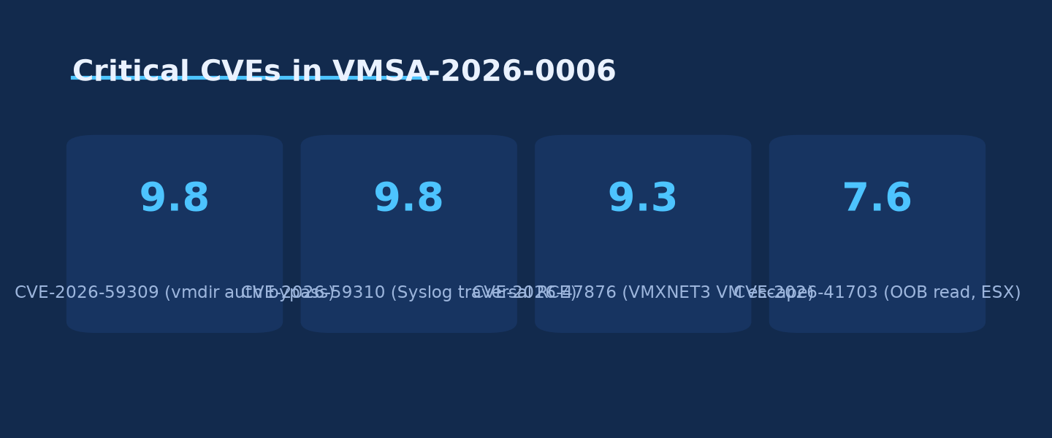
BY THE NUMBERS
Five CVEs ship together -- but severity is not
evenly spread across the advisory
Source: Broadcom Support Portal VMSA-2026-0006 (2026).
Credit: Ask Anything analysis, generated from VMSA-2026-0006 cited data.
Created with AskAnything - askanything-app.com
6
Created with AskAnything · askanything-app.com
Notes:
The advisory bundles five CVEs, but the two vCenter flaws (9.8) dominate the risk picture relative to the VM-escape (9.3) and lower-severity information-disclosure and logging bugs. Patch prioritization should reflect this spread.

Slide 7
VENDOR DISCLOSURE POSTURE
Broadcom confirmed the what -- not the how
✓
KNOWN / CONFIRMED
?
WITHHELD / UNDISCLOSED
• Affected component names (vmdir; Syslog Server)
• Vulnerable request, endpoint, or RPC path
• CVSS base scores and full vectors
• Specific LDAP/STS/token parsing defect
• CWE classifications (303; 22)
• Exact traversal primitive for the RCE
• Fixed build numbers for all product lines
• Whether the two CVEs are chainable
• No workaround exists -- patch only
• Any public exploit code or IOC signature
Source: Penligent Hacking Labs (2026) -- independent technical review of advisory language.
Created with AskAnything - askanything-app.com
7
Created with AskAnything · askanything-app.com
Notes:
Distinguish vendor-confirmed facts from withheld technical detail. This split drives the detection guidance later in the deck: presence detection is mature, exploitation detection is not possible yet because the mechanism is unknown.

Slide 8
SCOPING
Three more CVEs ride in the same advisory --
different threat models, same patch train
CVE
CVSS
Issue
Precondition
CVE-2026-47876
9.3
VMXNET3 out-of-bounds write -- guest-to-host VM escape
Requires existing admin access inside a guest VM
CVE-2026-41703
7.6 / 2.7
Out-of-bounds read -- info disclosure or DoS
Affects ESX, Workstation, Fusion
CVE-2026-41709
2.7
Insufficient ESX administrative logging
Audit-trail integrity, not remote exploitation
NSX, vCenter Operations, and vCenter Automation are explicitly NOT affected by this advisory.
Source: Broadcom Support Portal VMSA-2026-0006 (2026); Field Effect (2026).
Created with AskAnything - askanything-app.com
8
Created with AskAnything · askanything-app.com
Notes:
Defenders patching the two critical vCenter CVEs will almost always patch these three simultaneously since they ship in the same VMSA and overlapping fixed-version trains. The VM escape (47876) has a materially different threat model -- it requires an existing guest compromise.

Slide 9
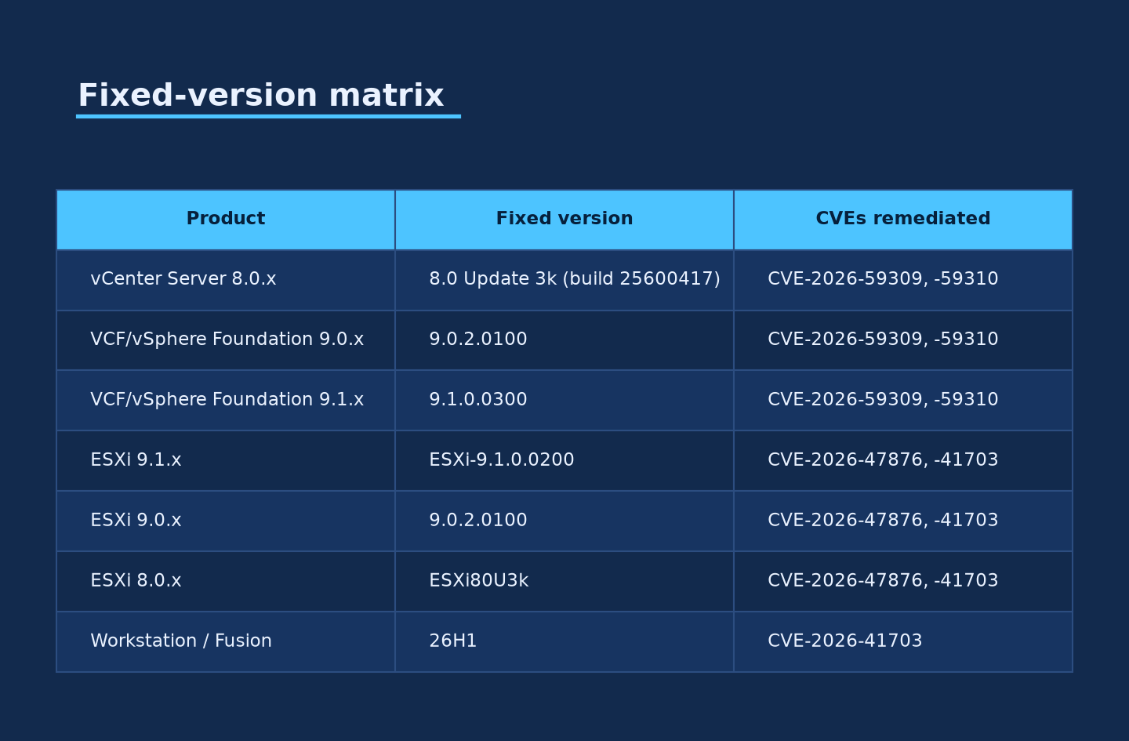
PATCH REFERENCE
The fix is not one build -- match your product
line to the exact fixed version
Source: Broadcom Support Portal (2026); Broadcom TechDocs (2026); CCCS AV26-763 (2026).
Credit: Ask Anything analysis, generated from VMSA-2026-0006 cited data.
Created with AskAnything - askanything-app.com
9
Created with AskAnything · askanything-app.com
Notes:
Headline fix: vCenter Server 8.0 Update 3k (build 25600417), VCF/vSphere Foundation 9.0.2.0100, and 9.1.0.0300 all remediate both critical CVEs. Emphasize build-number precision -- 8.0 U3j vs U3k is the entire security boundary.

Slide 10
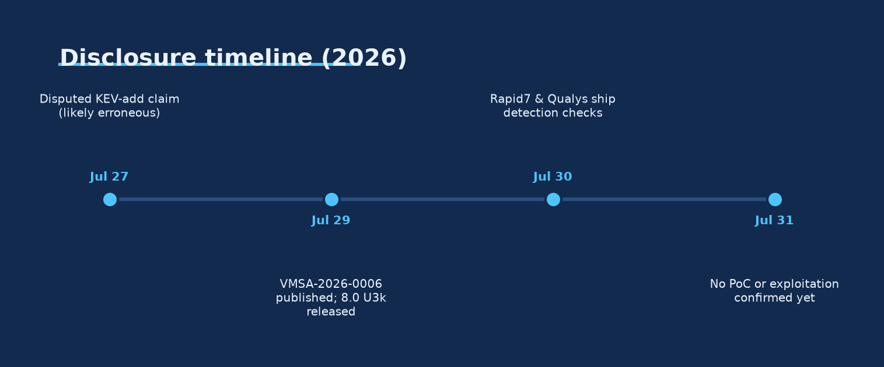
TIMELINE
Two to three days post-disclosure, defenders
have detection tools but no exploit code -- yet
Source: Broadcom Support Portal (2026); Rapid7 (2026); Qualys ThreatPROTECT (2026).
Credit: Ask Anything analysis, generated from VMSA-2026-0006 cited data.
Created with AskAnything - askanything-app.com
10
Created with AskAnything · askanything-app.com
Notes:
July 29: advisory published. July 30: Rapid7 and Qualys ship version-detection. July 31 (today, per this report's research window): no confirmed exploitation or public PoC. Rapid7's 10x KEV history for vCenter argues this window will not last.

Slide 11
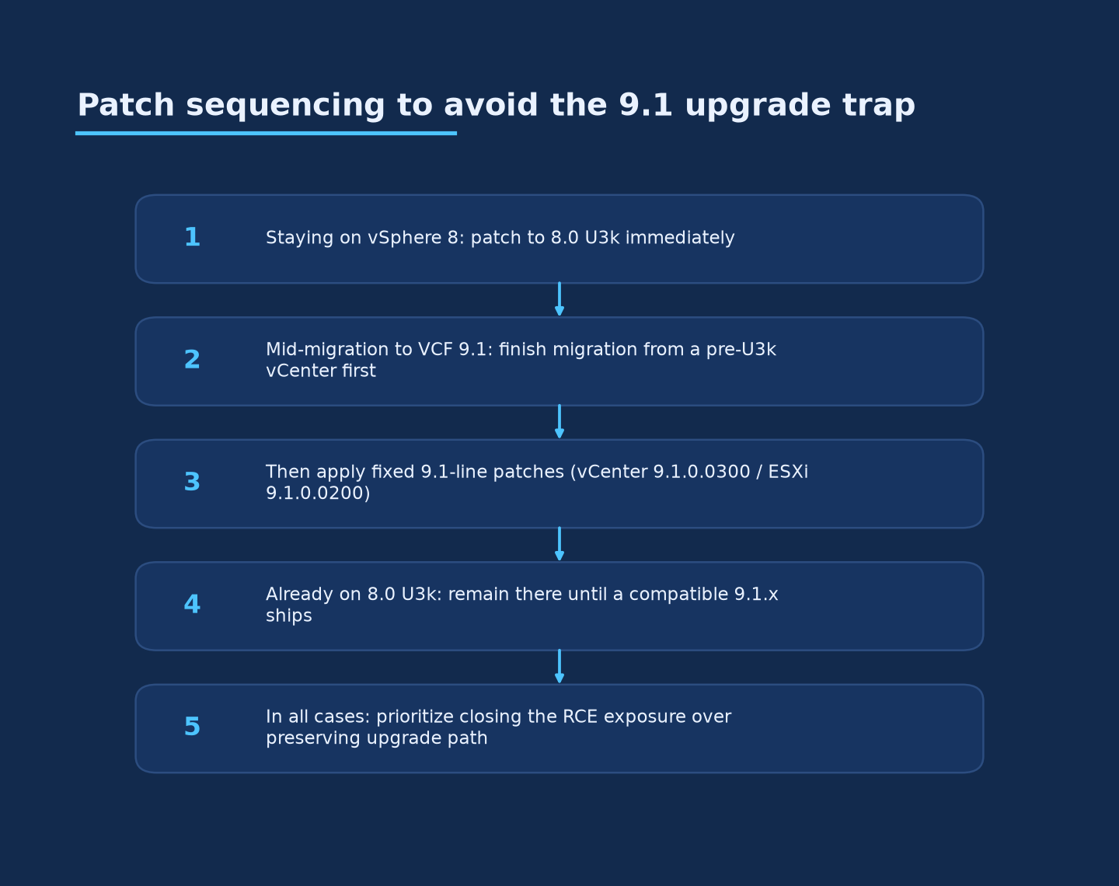
OPERATIONAL TRAP
Patching to 8.0 U3k first can strand a VCF 9.1
migration for months
VENDOR STATEMENT
“Upgrade from vCenter 8.0 Update 3k to vCenter 9.1.0 or any patch based on 9.1.0 is not supported.”
8.0 U3k contains security fixes not yet present in the shipping 9.1.0 baseline. Installing 9.1.0 over it would silently regress those fixes -- a downgrade Broadcom's policy disallows.
Credit: Ask Anything analysis, generated from VMSA-2026-0006 cited data.
Source: Broadcom TechDocs vCenter 8.0 U3k Release Notes (2026); AngrySysOps (2026).
Created with AskAnything - askanything-app.com
11
Created with AskAnything · askanything-app.com
Notes:
This is the single most operationally important nuance in the report. Teams mid-migration to VCF 9.1 must sequence: finish the 9.1 upgrade FIRST from a pre-8.0-U3k baseline, then apply 9.1.0.0300 -- never patch to 8.0 U3k first if a 9.1 migration is in flight.

Slide 12
EXPLOITATION STATUS
No known exploitation today is a snapshot,
not a forecast
0
0
10x
Confirmed in-the-wild
exploitation events
Public proof-of-concept
exploits found
vCenter Server additions to
CISA's KEV catalog, historically
Absence of a PoC likely reflects patch-diff reverse-engineering still in progress -- not exploit difficulty.
Source: Rapid7 (2026); Broadcom Support Portal (2026); BleepingComputer (2026).
Created with AskAnything - askanything-app.com
12
Created with AskAnything · askanything-app.com
Notes:
As of July 30-31, 2026, no confirmed exploitation and no public PoC exist for either CVE. But vCenter has hit CISA's KEV catalog ten separate times historically -- treat the current quiet window as time-boxed, not durable.

Slide 13
FACT-CHECK
A widely-cited KEV addition date does not
survive a basic timeline check
CLAIM: CVE-2026-59309 was added to CISA's KEV catalog on July 27, 2026
That date is two days BEFORE Broadcom's own July 29, 2026 advisory publication -- an implausible sequence.
Jul 27
Jul 29
Jul 30
Claimed KEV
addition date
VMSA-2026-0006
published
NVD CISA-ADP:
exploitation = “none”
Verdict: treat the July 27 KEV claim as unverified / likely erroneous. Check CISA's catalog directly -- KEV status is one of the fastest-changing facts in this dossier.
Source: answer.md Evidence & caveats; NVD CVE-2026-59309 CISA-ADP SSVC supplement (2026).
Created with AskAnything - askanything-app.com
13
Created with AskAnything · askanything-app.com
Notes:
A secondary aggregator's KEV-addition date predates the advisory itself, which is not possible under CISA's own inclusion criteria. NVD's own supplemental data shows exploitation status 'none' as of July 30. Flag this explicitly so defenders don't over-index on a bad data point.

Slide 14
DETECTION GUIDANCE
Two detection tiers -- one mature today,
one only as good as your baseline
1
TIER 1 -- PRESENCE DETECTION
2
TIER 2 -- BEHAVIORAL DETECTION
Version fingerprinting -- available now
Pending disclosed IOCs -- start now
• Rapid7 InsightVM / Nexpose / Exposure Command (Jul 30)
• Admin vCenter sessions lacking a matching IdP auth event
• Qualys QIDs 388184, 216356, 216358 (Jul 30)
• vmdir log anomalies: unusual binds, TLS/SSL errors
• Detects vulnerable version strings, not exploit attempts
• SSO principal/group diffs against a known-good baseline
• Baseline action: enumerate every vCenter instance's exact build number
• Syslog traffic arriving from outside the expected source set
Source: Rapid7 (2026); Qualys ThreatPROTECT (2026); Penligent Hacking Labs (2026).
Created with AskAnything - askanything-app.com
14
Created with AskAnything · askanything-app.com
Notes:
Presence/version detection is mature and should be deployed immediately via existing VM tooling. Behavioral detection is the only option pending a disclosed exploitation mechanism, and it only works if the baseline was collected before an intrusion, not after.

Slide 15
RISK REDUCTION, NOT RISK ELIMINATION
Seven compensating controls buy time --
none of them close the vulnerability
Network-isolate the vCenter management interface to a tightly controlled subnet
Require jump-host / bastion access for all administrative vCenter access
1
2
Enforce phishing-resistant MFA on every remote path into the management plane
Restrict or disable unnecessary reachability to the Syslog Server component
3
4
Move to daily review of SSO admin sessions and vmdir logs until patched
Segment / snapshot-isolate the vCenter appliance to constrain blast radius
5
6
Source: Broadcom Support Portal VMSA-2026-0006 FAQ (2026); answer.md interim mitigations.
Compress patch validation cycles -- accelerate testing, not the timeline itself
None of items 1-7 substitute for patching to 8.0 U3k / 9.0.2.0100 / 9.1.0.0300.
7
Created with AskAnything - askanything-app.com
15
Created with AskAnything · askanything-app.com
Notes:
Broadcom's own FAQ stops short of endorsing any specific compensating control as sufficient. Frame these as dwell-time reduction for organizations with a legitimate, time-boxed reason not to patch within days -- not a durable alternative to patching.

Slide 16
90-DAY BLUEPRINT
Inventory first, then branch on migration status --
sequencing errors strand the estate
STEP 1
STEP 2A
STEP 2B
STEP 3
Inventory
Not migrating to 9.1?
Mid-migration to VCF 9.1?
Detect & Monitor
Identify every vCenter instance,
standalone and embedded, against
the exact build-number matrix.
Patch to 8.0 U3k (or 9.0.2.0100 /
9.1.0.0300 if already there) as an
emergency change, now.
Finish the 9.1 upgrade FIRST from
the pre-patch baseline, then apply
9.1.0.0300 / ESXi 9.1.0.0200.
Deploy Tier 1 version detection now;
stand up Tier 2 behavioral baselines
before, not after, an incident.
Source: answer.md Practical synthesis -- decision framework (steps 1-7).
Re-check exploitation and KEV status daily for the first several weeks post-disclosure, given the historical base rate of vCenter vulnerabilities converting to active exploitation.
Created with AskAnything - askanything-app.com
16
Created with AskAnything · askanything-app.com
Notes:
This is the closing recommendation slide. The single most important branch point is step 2A vs 2B -- getting the migration sequencing wrong strands the estate on an unsupported upgrade path per Broadcom's own release notes.

Slide 17
ONGOING MEASUREMENT
Track four signals to know if the response
is actually working
Patch compliance rate
Mean time to patch
Across all vCenter instances (standalone + embedded) vs. the fixed-version matrix
This advisory vs. your organization's historical vCenter patch SLA
Uncorroborated admin sessions
Syslog source-IP drift
Count of vCenter admin sessions/day lacking a matching IdP authentication event
Inbound syslog traffic arriving from outside the expected, scoped source set
Source: answer.md Practical synthesis -- "What to measure going forward."
Created with AskAnything - askanything-app.com
17
Created with AskAnything · askanything-app.com
Notes:
These four metrics operationalize the response: patch compliance and MTTP measure remediation progress, while the session and syslog drift metrics measure whether behavioral detection baselines are catching anomalies.

Slide 18
RECOMMENDATION
Patch is the only remediation. Sequence the
migration correctly, and detect while you wait.
1
Inventory every vCenter instance's exact build number today -- do not rely on "vSphere 8" or "VCF 9" granularity.
2
Patch to 8.0 U3k / 9.0.2.0100 / 9.1.0.0300 as an emergency change with compressed, not skipped, validation.
3
If mid-migration to VCF 9.1, finish the upgrade first, then patch -- reversing this order strands the environment.
4
Deploy Tier 1 version detection immediately; stand up Tier 2 behavioral baselines now, before an incident forces it.
Broadcom's own guidance is unanimous: closing the unauthenticated-RCE-class exposure takes priority over preserving a future upgrade path.
Created with AskAnything - askanything-app.com
18
Created with AskAnything · askanything-app.com
Notes:
Closing slide. The four recommendations are ordered by dependency: you cannot sequence step 2/3 correctly without step 1's inventory, and detection (step 4) should start in parallel with patching, not after.

Slide 19
SOURCES
Primary references
1. VMSA-2026-0006 -- Broadcom Support Portal Security Advisory (2026)
2. VMSA-2026-0006 FAQ/Q&A -- vmware/vcf-security-and-compliance-guidelines, GitHub (2026)
3-4. NVD -- CVE-2026-59309 and CVE-2026-59310 Detail Pages
5. VMware vCenter Server 8.0 Update 3k Release Notes -- Broadcom TechDocs (2026)
6. "Critical VMware vCenter Vulnerabilities..." -- Rapid7 Blog (2026)
9. "VMware ESX, vCenter, Workstation, and Fusion Multiple Vulnerabilities" -- Qualys ThreatPROTECT (2026)
10. "CVE-2026-59309: VMware vCenter Authentication Bypass..." -- Penligent Hacking Labs (2026)
11. "vSphere 8.0 Update 3k Fixes Critical CVEs..." -- AngrySysOps (2026)
Full 22-source list available in the underlying report (answer.md).
Explore more questions at Ask Anything
Created with AskAnything - askanything-app.com
19
Created with AskAnything · askanything-app.com
Notes:
Compact source list covering the eight most load-bearing references. The full report cites 22 sources; defenders should consult Broadcom's advisory directly (source 1) as the authoritative reference.

