Slide 1
GLP-1–Based Therapeutics Beyond Weight Loss
Advanced clinical review, organ outcomes, and 2026 breakthroughs

Slide 2
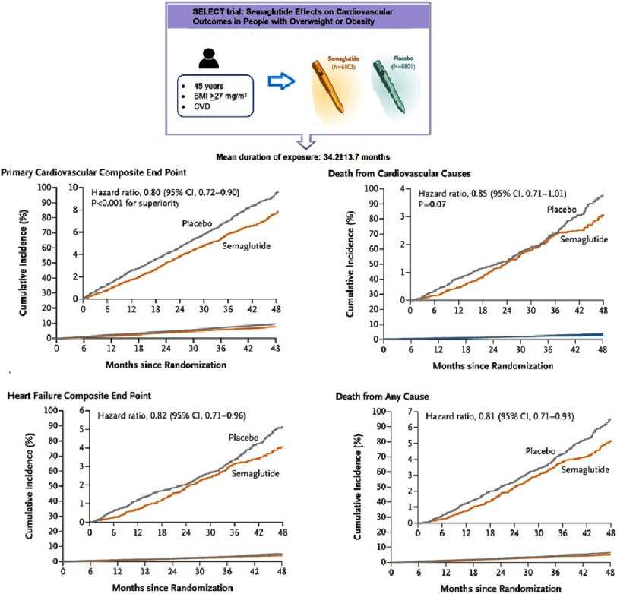
Incretin therapy is now organ-directed risk modification
• SELECT established secondary cardiovascular prevention
• FLOW demonstrated dedicated kidney-outcome benefit
• HFpEF and OSA trials changed phenotype-based care
• MASH histology supported accelerated approval
SELECT reframed obesity treatment as cardiovascular risk reduction in people with established disease. · Banach et al., Global Cardiology Science & Practice (2024), Figure 3; summarizes SELECT
Ask Anything · cited, honest, current

Slide 3
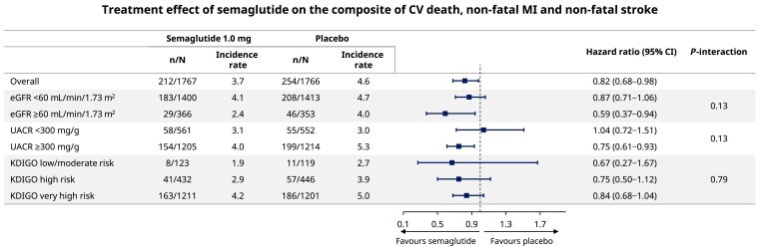
Receptor pharmacology limits class-wide extrapolation
• GLP-1R signaling is glucose dependent
• Semaglutide has an approximately one-week half-life
• Tirzepatide combines GIPR and GLP-1R agonism
• Molecule, dose, and population define the evidence
FLOW: cardiovascular outcomes with semaglutide across chronic kidney disease severity. · FLOW secondary analysis, European Heart Journal (2025), Figure 2
Ask Anything · cited, honest, current

Slide 4
SELECT moved beyond surrogate risk factors
HR 0.80
three-point MACE; 6.5% versus 8.0% over 39.8 months
Ask Anything · cited, honest, current

Slide 5
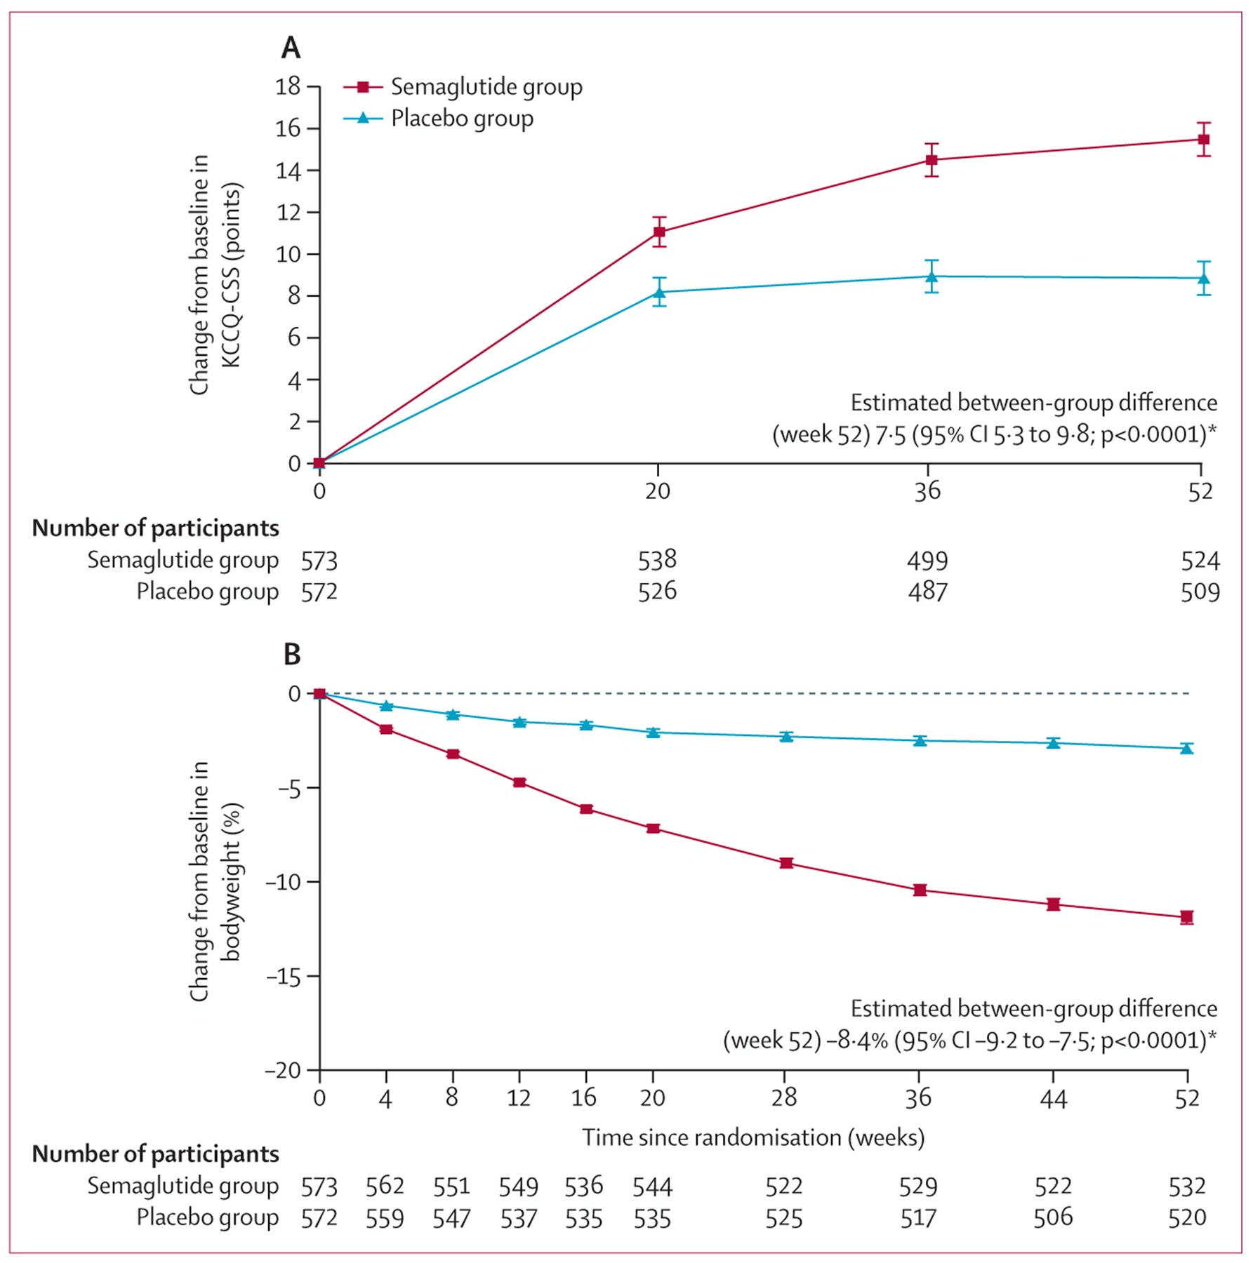
FLOW established kidney protection in high-risk diabetic CKD
• 3,533 participants with albuminuric CKD
• Primary kidney composite reduced by 24%
• Annual eGFR decline was attenuated
• Integrate with SGLT2 and standard CKD therapy
STEP-HFpEF pooled results: symptoms and body weight improved across people with and without diabetes. · Butler et al., The Lancet (2024), Figure 1
Ask Anything · cited, honest, current

Slide 6
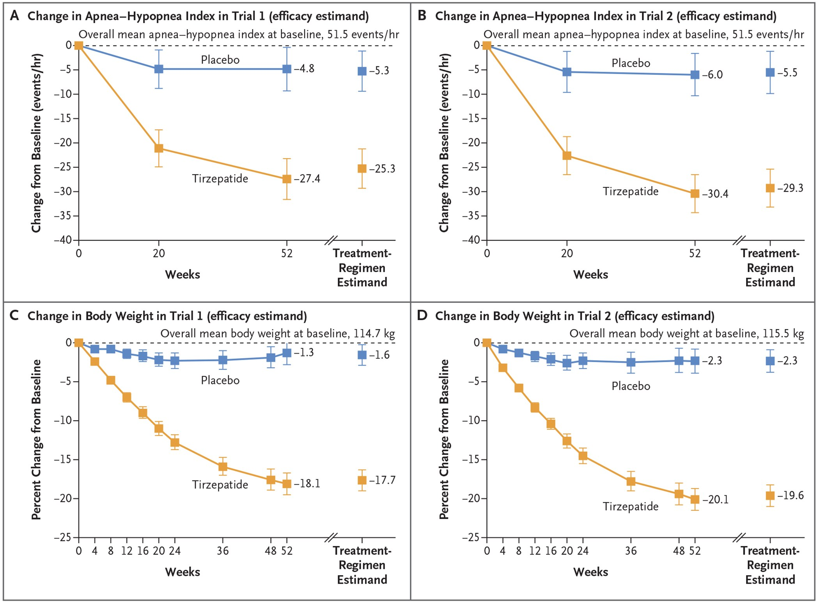
Obesity-related HFpEF is a treatable clinical phenotype
• KCCQ symptoms and function improved
• Six-minute walk distance increased
• Tirzepatide added event-level evidence
• Track congestion and function, not weight alone
SURMOUNT-OSA participant flow and trial structure across PAP and non-PAP cohorts. · Malhotra et al., New England Journal of Medicine (2024), Figure 1; PMC author manuscript
Ask Anything · cited, honest, current

Slide 7
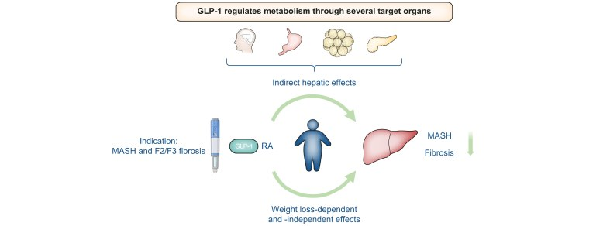
SURMOUNT-OSA created the first pharmacologic OSA indication
• Baseline AHI approached 50 events per hour
• Treatment difference was approximately 20–24 events/hour
• Indication requires moderate-to-severe OSA with obesity
• Repeat testing should guide PAP de-escalation
ESSENCE links metabolic treatment to improvement in steatohepatitis and fibrosis. · Ratziu et al., United European Gastroenterology Journal (2025), Figure 1
Ask Anything · cited, honest, current

Slide 8
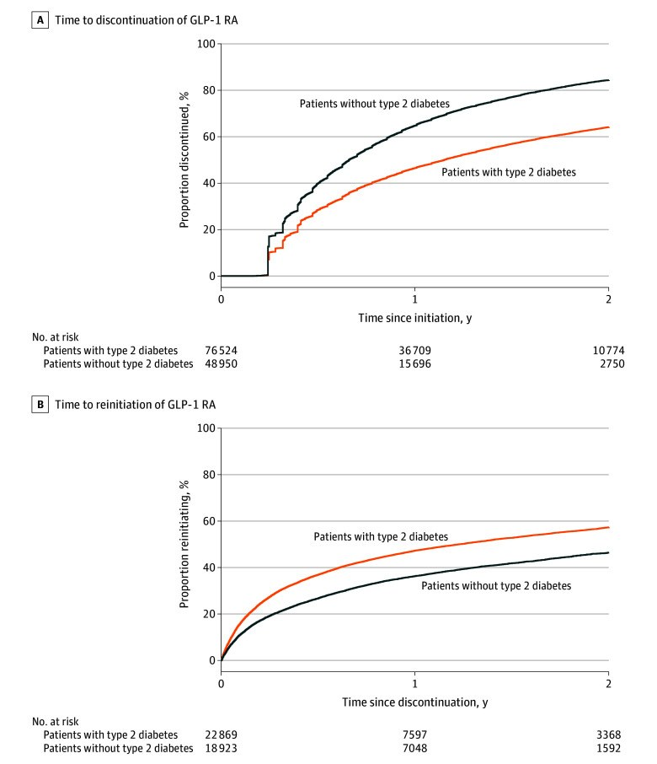
MASH approval is histology-based and conditional
• ESSENCE enrolled biopsy-confirmed F2–F3 disease
• Steatohepatitis resolution and fibrosis improved
• Accelerated approval requires outcome confirmation
• Do not equate steatosis with labeled MASH
Real-world discontinuation is substantially higher among people without type 2 diabetes. · Rodriguez et al., JAMA Network Open (2025), Figure 1
Ask Anything · cited, honest, current

Slide 9
Visual change and myalgia require differential assessment
• Consider rapid-glycemia refractive change and retinopathy
• Sudden monocular loss requires urgent assessment
• Myalgia is not a canonical common adverse effect
• Evaluate hydration, CK, thyroid, statin, and systemic causes
Ask Anything · cited, honest, current

Slide 10
Persistence is the largest real-world effectiveness gap
• 64.8% without diabetes discontinued by one year
• Coverage and GI toxicity drive interruption
• Withdrawal commonly produces weight regain
• Plan maintenance before treatment initiation
Ask Anything · cited, honest, current

Slide 11
The pipeline is promising but outcome evidence remains decisive
• Alcohol and dementia signals remain investigational
• Dual, triple, and amylin combinations are advancing
• Oral delivery may expand access and adherence
• Demand durability, safety, and active-comparator outcomes
Ask Anything · cited, honest, current

Slide 12
Selected pivotal evidence
• SELECT — NEJM 2023
• FLOW — NEJM 2024
• STEP-HFpEF — Lancet 2024
• SURMOUNT-OSA — NEJM 2024
• ESSENCE and FDA labeling — 2025–2026
Ask Anything · cited, honest, current

