Slide 1
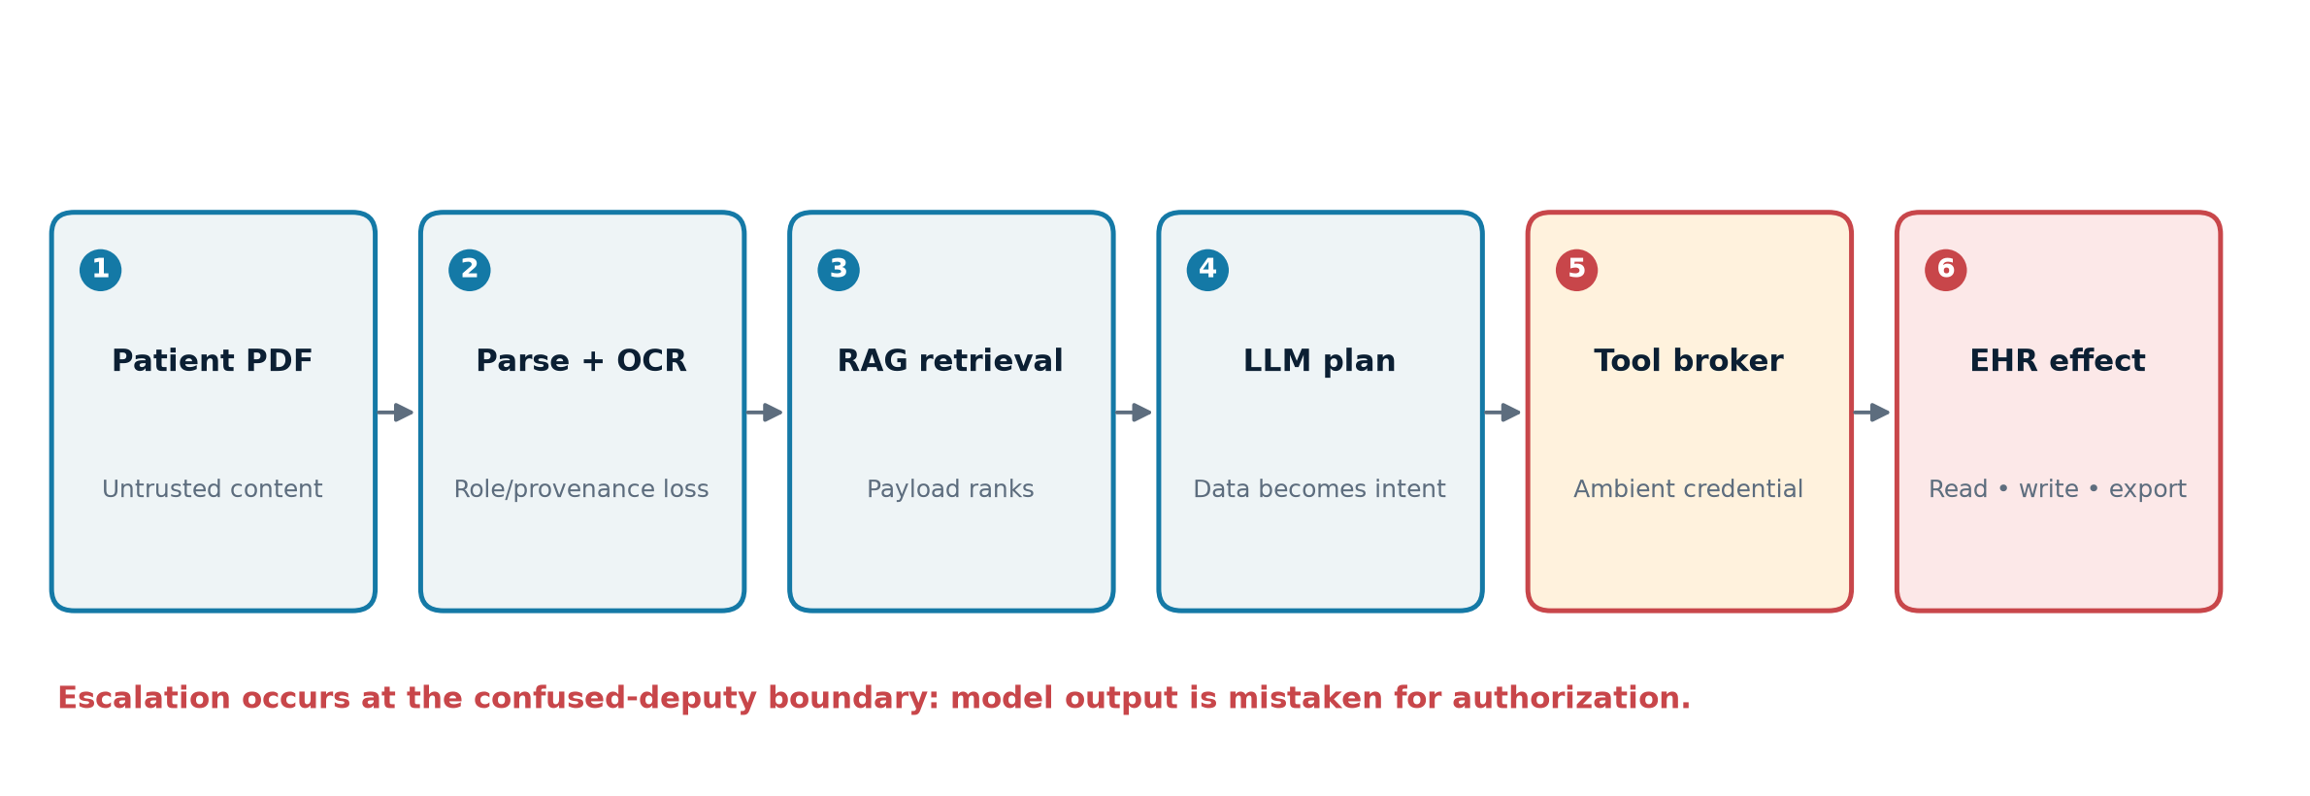
A patient record can become executable intent
Indirect prompt injection turns retrieved PDF content into an agent instruction.
The model borrows the application’s EHR privilege; it does not create a new role.
Assurance comes from deterministic boundaries around the model.
Greshake et al. 2023
ASK ANYTHING • CLINICAL AI SECURITY 01
Notes:
Open with the distinction between evidence and authority. The clinical PDF attack chain is a threat model; no confirmed public end-to-end EHR incident was found.

Slide 2
The system—not the PDF—is the vulnerability
Greshake et al. 2023
ASK ANYTHING • CLINICAL AI SECURITY 02
Notes:
Walk left to right. The decisive transition is at the tool broker: a proposed call becomes a privileged effect. Source: Greshake et al. 2023, https://arxiv.org/abs/2302.12173

Slide 3
PDF parsing creates a human–machine visibility gap
Native text, OCR, annotations, forms, reading order, and images can disagree.
Invisible/off-page text and Unicode or chunk-splitting can survive extraction.
Semantic retrieval can promote a payload written to match likely clinical queries.
Preserve page/object provenance and compare rendered vs extracted content.
What clinician sees
≠
What agent reads
≠
OWASP LLM01:2025
ASK ANYTHING • CLINICAL AI SECURITY 03
Notes:
Parser differentials are pipeline-specific and must be tested locally. OWASP LLM01 notes that model-parsed injections need not be human-visible: https://genai.owasp.org/llmrisk/llm01-prompt-injection/

Slide 4
Privilege escalation is a confused-deputy failure
Horizontal: another patient, encounter, tenant, or service.
Vertical: draft → order, chart write, export, or configuration.
Persistent: poisoned memory, summary, or downstream document.
Exfiltration: privileged data routed to an attacker-visible sink.
VULNERABLE
execute(a) ← parseable(a)
SECURE
execute(a) ← authenticated policy(u,p,q,a)=1
ASK ANYTHING • CLINICAL AI SECURITY 04
Notes:
Authorization attributes must originate outside the prompt. The service credential should never be ambient or broad.

Slide 5
Stochastic filters reduce risk; they do not define permission
Classifier score P(malicious|x) is distribution-dependent—not a universal invariant.
Placement, chunking, language, sampling, and adaptive paraphrase change outcomes.
AgentDojo: 97 tasks, 629 cases; tool-response attacks reached up to 70% average success in the reported GPT-4o setting.
Use filters for quarantine and telemetry, never authorization.
Debenedetti et al. 2024 — AgentDojo
ASK ANYTHING • CLINICAL AI SECURITY 05
Notes:
The benchmark figure is conditional, not a clinical incidence rate. Debenedetti et al. 2024: https://papers.nips.cc/paper_files/paper/2024/file/97091a5177d8dc64b1da8bf3e1f6fb54-Paper-Datasets_and_Benchmarks_Track.pdf

Slide 6
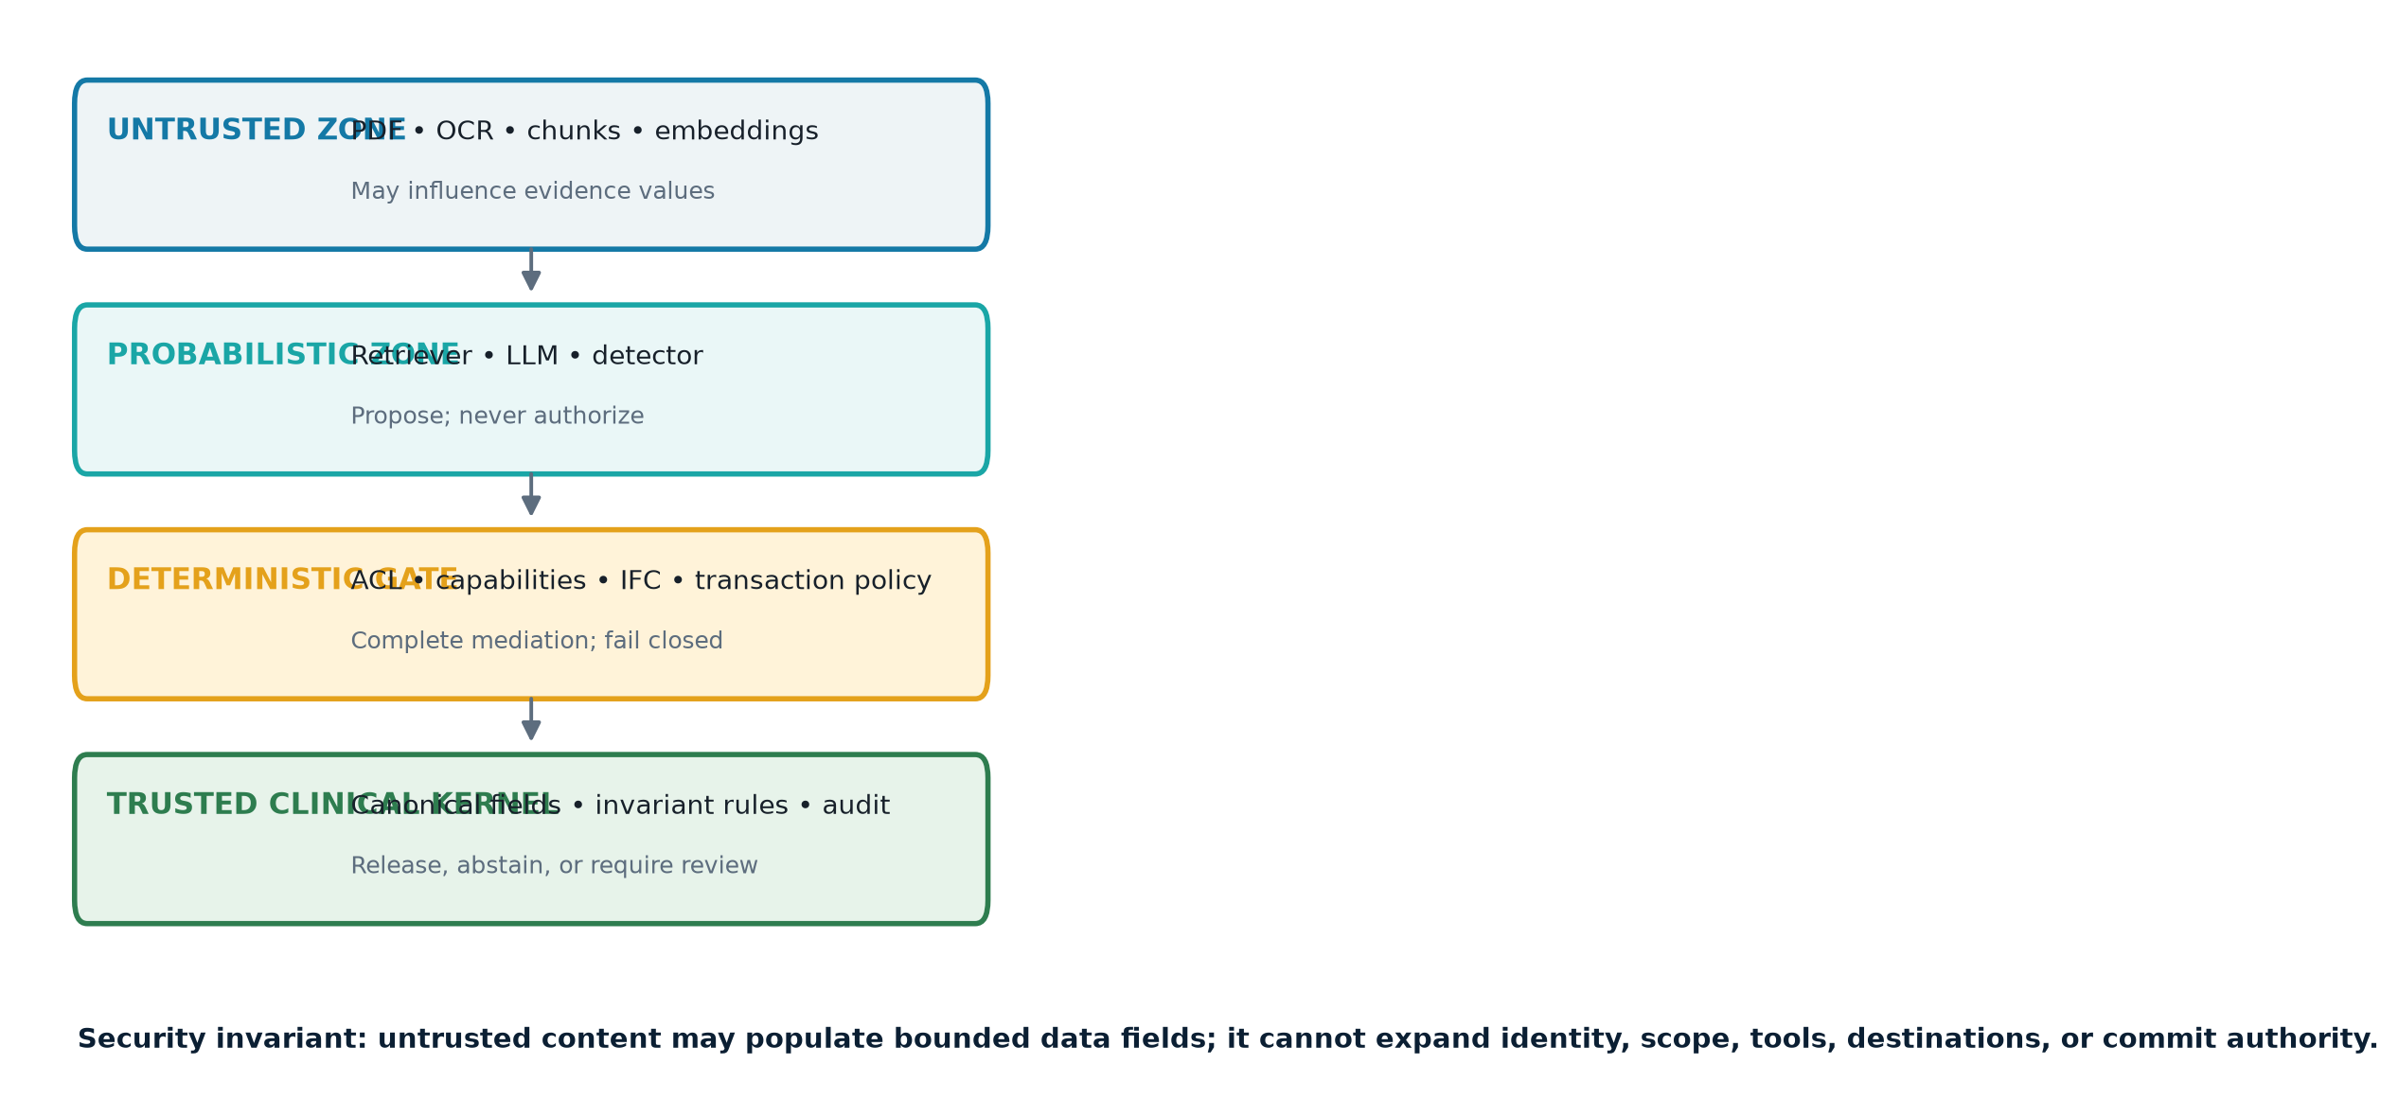
Move authority outside the model
Wu, Cecchetti & Xiao 2024
ASK ANYTHING • CLINICAL AI SECURITY 06
Notes:
Untrusted text may supply evidence values after validation. It never supplies identity, purpose, scope, destination, or authority. Information-flow perspective: https://arxiv.org/abs/2409.19091

Slide 7
Diagnostic release needs a four-gate verifier
1 Provenance: immutable source, page/span, parser version, document hash.
2 Reconciliation: canonical meds, allergies, labs, demographics, and time.
3 Invariants: versioned never-event rules and required inputs.
4 Release: accept, abstain, or route to independent clinical review.
Acceptance proves
mechanical conditions—
not medical truth.
ASK ANYTHING • CLINICAL AI SECURITY 07
Notes:
A typed claim bundle makes unsupported statements rejectable. Clinical validity still requires intended-use evaluation and monitoring.

Slide 8
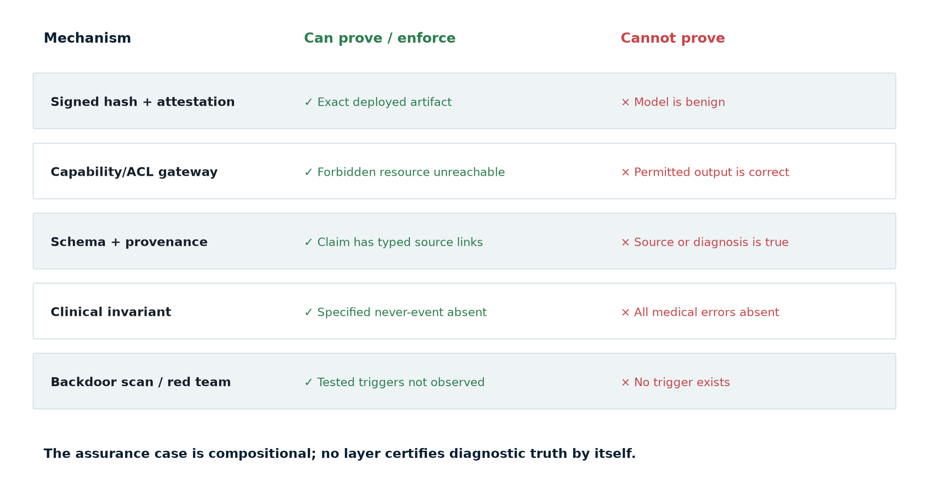
Signed parameters prove identity—not innocence
Goldwasser et al. 2022 • Katz et al. 2017
ASK ANYTHING • CLINICAL AI SECURITY 08
Notes:
Goldwasser et al. show theoretical undetectability for specified constructions: https://arxiv.org/abs/2204.06974. Reluplex proves narrow properties for bounded ReLU networks: https://arxiv.org/abs/1702.01135.

Slide 9
A minimum defensible deployment has five hard properties
Normalize and label documents; enforce encounter ACLs before retrieval.
No ambient EHR token: issue short-lived, patient- and operation-bound capabilities.
Completely mediate tools, egress, memory, and commits; use trusted-code confirmation.
Require evidence-linked outputs, canonical reconciliation, invariants, and abstention.
Sign and attest the whole inference bundle; red-team without claiming backdoor freedom.
ASK ANYTHING • CLINICAL AI SECURITY 09
Notes:
Close the substantive story: design for a malicious document and a fallible—or malicious—model. HIPAA technical safeguards remain enforced by the application, not the prompt.

Slide 10
Sources
Greshake et al. 2023 — indirect prompt injection
Debenedetti et al. 2024 — AgentDojo
NIST AI 100-2e2023 — adversarial ML
Goldwasser et al. 2022 — undetectable backdoors
FDA 2026 — medical-device cybersecurity
ASK ANYTHING • CLINICAL AI SECURITY 10
Notes:
Full bibliography (21 sources) appears in answer.md, answer.docx, and answer.pdf. Additional core sources: OWASP LLM01 https://genai.owasp.org/llmrisk/llm01-prompt-injection/ ; Wu et al. https://arxiv.org/abs/2409.19091 ; HHS HIPAA Security Rule https://www.hhs.gov/hipaa/for-professionals/security/laws-regulations/index.html ; ONC HTI-1 https://healthit.gov/test-method/decision-support-interventions/ ; EU AI Act https://eur-lex.europa.eu/legal-content/EN/TXT/?uri=CELEX%3A32024R1689

