Slide 1
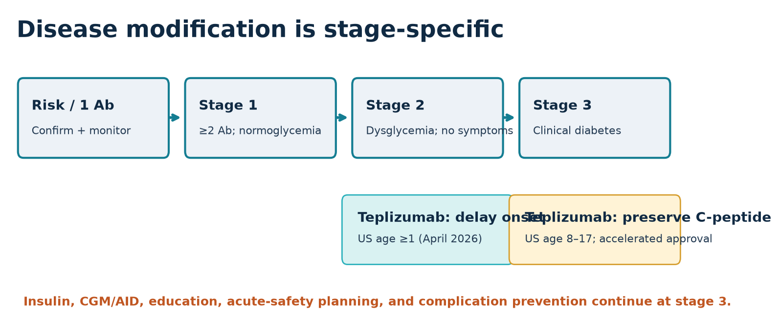
TYPE 1 DIABETES IN 2026
Cure research has crossed a threshold—
but the immune barrier still defines the field
Clinical evidence review • current to 21 July 2026
Notes:
Open by separating cure headlines from the clinical endpoint. The field can now manufacture functional islets, but durable immune-safe replacement remains unsolved.

Slide 2
A cure has six simultaneous requirements
TAKEAWAY / INSULIN INDEPENDENCE ALONE IS NOT ENOUGH
Glucose-responsive cell mass
No chronic immunosuppression
Durable function
Retrievable / controllable safety
Scalable manufacture
Equitable access
Framework synthesis from cell-therapy trials and regulatory risk–benefit criteria.
Notes:
Define biochemical engraftment, insulin independence, functional cure, and disease cure. Emphasize that population readiness adds manufacturing and access.

Slide 3
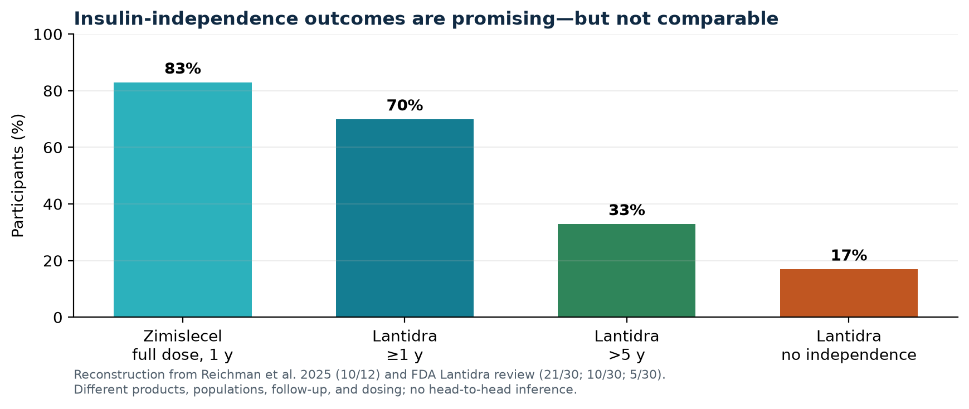
Manufactured islets now restore physiologic insulin secretion
TAKEAWAY / THE BIOLOGY WORKS UNDER IMMUNOSUPPRESSION
• Zimislecel: 10/12 full-dose recipients insulin-independent at 1 year
• All 12 met HbA1c <7% + no severe hypoglycemia after day 90
• Selected adults with impaired awareness and recurrent severe events
• Single-arm, small cohort; chronic immunosuppression required
Reichman et al., NEJM 2025, DOI 10.1056/NEJMoa2506549; FDA Lantidra review, 2023.
Notes:
Give denominators. Do not compare bar heights as head-to-head efficacy. The key comparator in future should be optimized AID, not historical injection therapy.

Slide 4
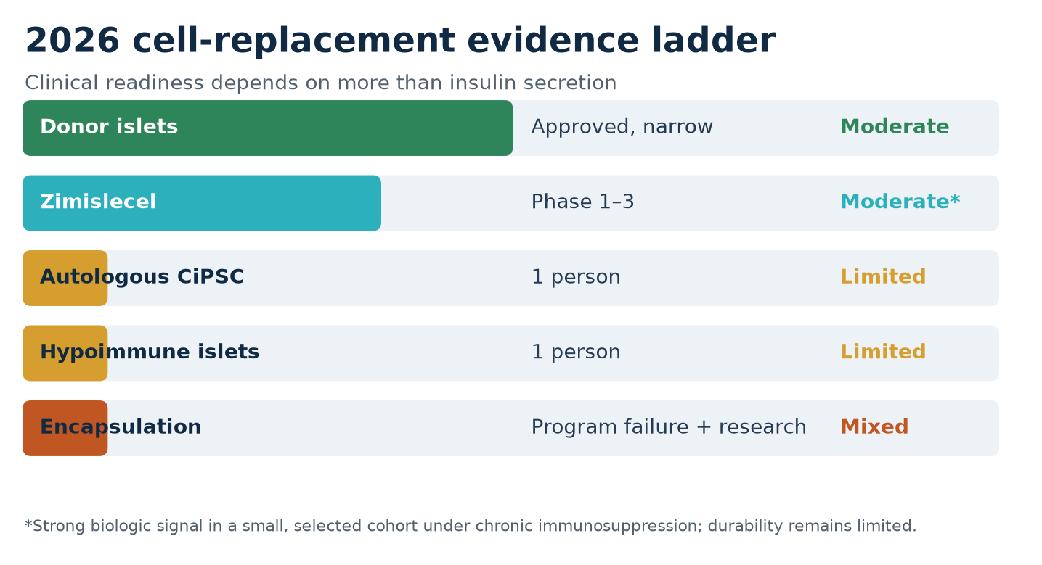
Immune protection—not cell production—is the bottleneck
TAKEAWAY / THREE ROUTES, NONE YET SOLVES THE FULL PROBLEM
• Systemic immunosuppression: effective, toxic over decades
• Hypoimmune editing: human proof of concept in one subtherapeutic graft
• Autologous cells: one insulin-independent case, already immunosuppressed
• Encapsulation: VX-264 stopped for insufficient efficacy
Carlsson et al., NEJM 2025; Wang et al., Cell 2024; Vertex pipeline update, 28 Mar 2025.
Notes:
Explain HLA reduction and CD47 concept without claiming safety. Note immune-surveillance and transformation risks are theoretical monitoring concerns, not observed outcomes.

Slide 5
Teplizumab moved disease modification into routine regulation
TAKEAWAY / 2026 EXPANDED WHO CAN BE TREATED
FDA approvals: 20 Apr 2026 (stage 2, age ≥1); 12 Jun 2026 accelerated approval (recent stage 3, age 8–17).
Notes:
Stage carefully. Stage 2 benefit is delayed onset, not prevention. Recent stage 3 approval is to delay decline in endogenous insulin production and retains full insulin standard care.

Slide 6
C-peptide preservation did not improve key glycemic endpoints
TAKEAWAY / SURROGATE BENEFIT REQUIRES ENDPOINT HONESTY
+0.13 pmol/mL
328
NULL
stimulated C-peptide at week 78
95% CI 0.09–0.17
children/adolescents
2:1 randomized
insulin dose, HbA1c, TIR,
important hypoglycemia
Accelerated approval uses C-peptide as a surrogate reasonably likely to predict clinical benefit; a confirmatory study is required.
Ramos et al., NEJM 2023, DOI 10.1056/NEJMoa2308743; FDA, 15 Jun 2026.
Notes:
Present the exact trial design: two 12-day courses, 26 weeks apart, recent diagnosis within six weeks. Separate biologic preservation from day-to-day glycemic experience.

Slide 7
Safety and logistics determine net value
TAKEAWAY / IMMUNE THERAPY CARRIES REAL BURDEN
• Teplizumab: boxed warning for viral reactivation; CRS, cytopenias, liver injury, hypersensitivity
• Plan CBC, liver tests, infection assessment, EBV/CMV vigilance, and vaccine timing
• Cell grafts: portal complications plus long-term immunosuppression toxicity
• Trials need graft surveillance, rescue/explant plans, and tumor monitoring
FDA Tzield label, 2026; FDA Lantidra label, 2023.
Notes:
Avoid turning this into an exhaustive dosing slide. The clinical point is that monitoring and travel burden shape access and benefit.

Slide 8
AID remains the highest-impact present-tense breakthrough
TAKEAWAY / RESEARCH THERAPIES MUST BEAT OPTIMIZED MODERN CARE
+9.99 points
• 16 trials; 669 participants
• Fully automated beat non-AID—not hybrid AID overall
• 2026 ADA: CGM from diagnosis; remove AID prerequisites
• Retain infusion-failure, ketone, and injection backup plans
mean time-in-range improvement
95% CI 3.75–16.22
Fan et al., Diabetes Obes Metab 2025, doi:10.1111/dom.16499; ADA 2026.
Notes:
Translate ten percentage points as roughly 2.4 extra hours per day in range, while noting heterogeneity and pooled comparators.

Slide 9
Adjunct drugs target phenotype—not autoimmunity
TAKEAWAY / METABOLIC GAINS COME WITH KETOSIS RISK
• Semaglutide + AID improved TIR, insulin dose, and weight in a 28-person crossover trial
• Two euglycemic ketosis episodes; no DKA or severe hypoglycemia
• GLP-1 RAs are not approved specifically for T1D and never replace insulin
• SGLT2 inhibitors are not FDA-approved for T1D; DKA may occur near-normal glucose
Pasqua et al., Nature Medicine 2025; Danne et al., Diabetes Care 2019.
Notes:
Stress careful insulin adjustment and ketone education. The small semaglutide trial should not be generalized to children, pregnancy, or people unable to monitor ketones.

Slide 10
The 2026 practice hierarchy is clear
TAKEAWAY / MATCH THE INTERVENTION TO DISEASE STAGE AND RISK
1
CGM + AID + education
Most established T1D
2
Stage + refer for teplizumab
Confirmed stage 2 / eligible recent stage 3
3
Transplant-center evaluation
Recurrent severe hypoglycemia despite optimized care
4
Authorized trials only
Stem-cell and immune-evasive products
Synthesis of ADA 2026, FDA labels, cell-therapy trials, and trial registries.
Notes:
This is a referral hierarchy, not a personal treatment algorithm. Recurrent severe events should trigger assessment of social and technology failures before transplant.

Slide 11
Five references anchor the 2026 evidence map
SOURCES / FULL BIBLIOGRAPHY IN PRESENTER NOTES AND ARTICLE
1. Reichman et al. NEJM 2025. doi:10.1056/NEJMoa2506549
2. FDA. Tzield stage 3 indication + label. June 2026
3. Ramos et al. NEJM 2023. doi:10.1056/NEJMoa2308743
4. FDA. Lantidra approval + label. 2023
5. Fan et al. Diabetes Obes Metab 2025. doi:10.1111/dom.16499
Complete 18-source bibliography, stable URLs, and trial IDs: answer.md / answer.pdf / answer.docx.
Notes:
Full bibliography: Reichman 2025; FDA Lantidra 2023; Carlsson 2025; Wang 2024; FDA Tzield 2026; Ramos 2023; FDA label 2026; Fan 2025; ADA 2026; Vertex 2025; Beese 2025; Quattrin 2020; Waibel 2023; Forlenza 2023; Considine 2024; Pasqua 2025; Danne 2019; NCT04786262.

